Slide 1

ATES
Technical, Constructions and Sustainability division
The green transition between sustainable experiences and projects
Bootcamp@UNICAM
7 of july, 23
Transportation
the future of sustainable mobility
DICAM
Department of Civil, Chemical, Environmental, and Materials Engineering
Roberto Battistini – Mobility Manager
PhD@DICAM

Slide 2
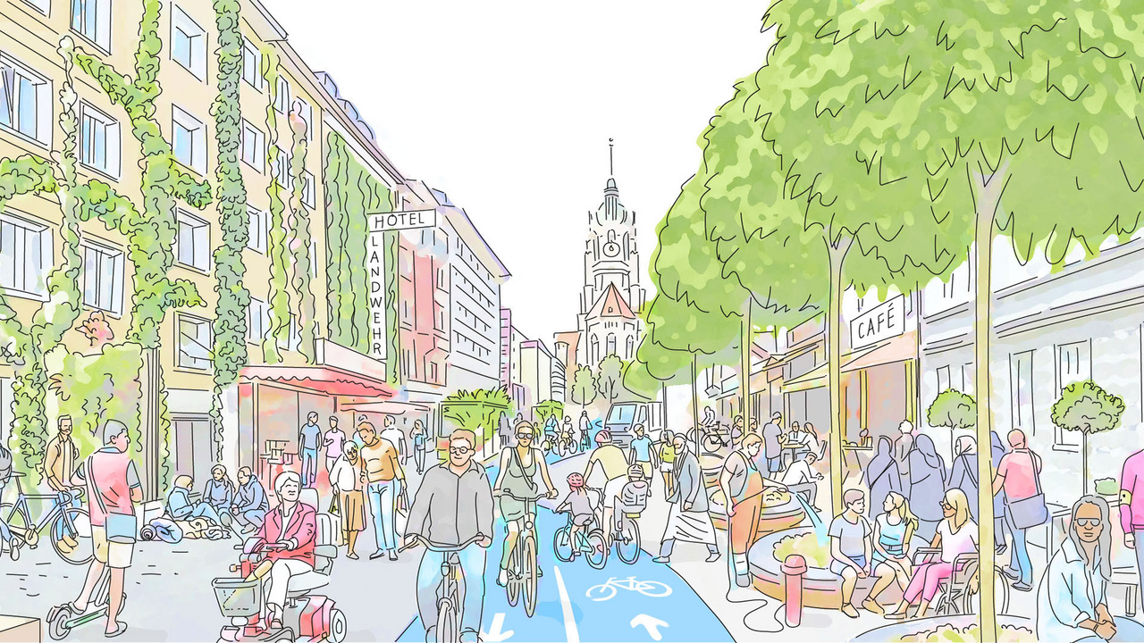

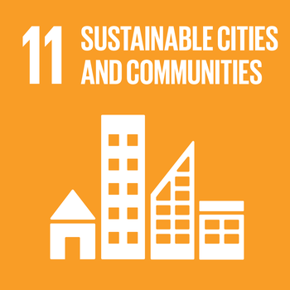
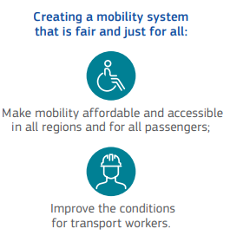
storytelling
Something about the future: measuring and interpreting urban systems
Fields
Adaptive paths of Transportation Offer to new dynamic approach of Transportation Demand.
Urban wellbeing paradigm
Enhance Urban sustainability transition
Notes:
Having to consider many aspects to reach Goal 11 of the "2030 Agenda", this study demonstrates how the old concept of infrastructure design must be abandoned in order to create new integrated actions that take into account all the areas that influence the growth of new "smart and sustainable cities".

Slide 3
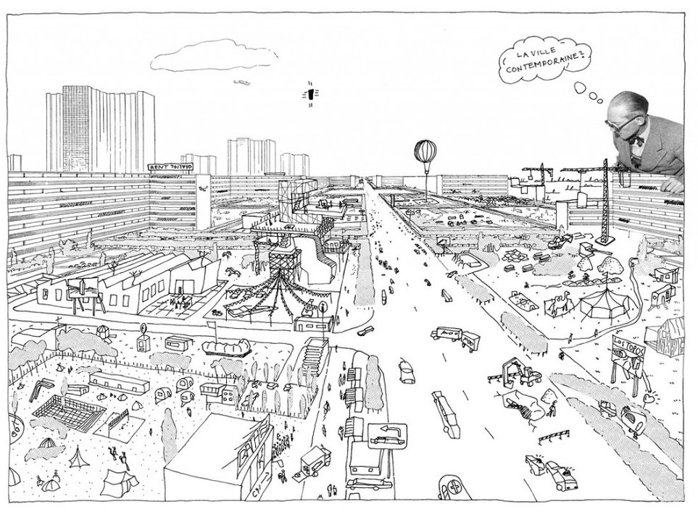
Introduction
Cities as ecosystems
Cities are in fact ecosystems. Tansley (1935) defined an ecosystem as a community of living organisms in conjunction with the nonliving components of their environment, interacting as a system.
Eugene Odum (1971) expanded the definition as a unit that includes all the organisms, i.e., the community in a given area interacting with the physical environment so that a flow of energy leads to clearly defined trophic structure, biotic diversity and material cycles, i.e., exchange of materials between living and non-living, within the system.

Slide 4
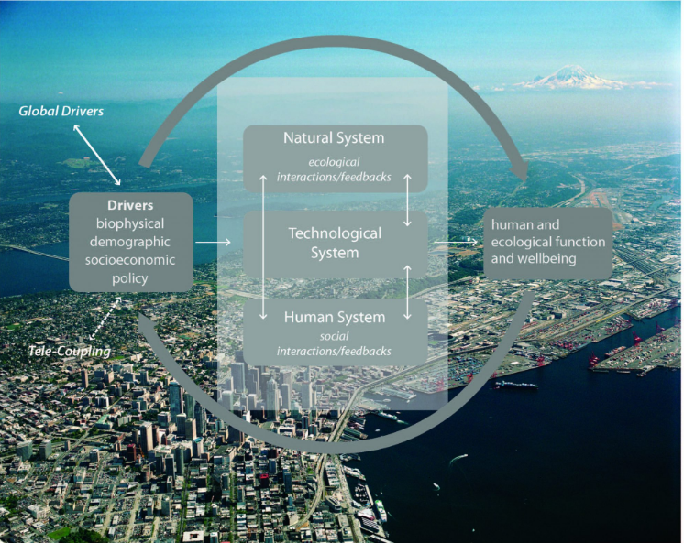
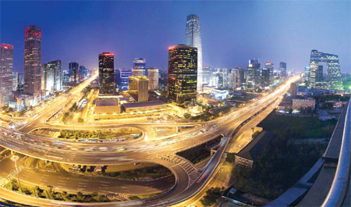

Introduction
Layers of hybrid urban ecosystems
Cities as hybrid ecosystems: the product of co-evolving human and natural systems. Urban ecosystems emerge from complex interactions and feedbacks between the human, natural and technological system components of urban ecosystems
(Alberti, 2016).

Slide 5

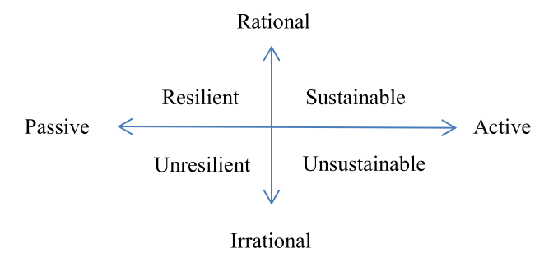
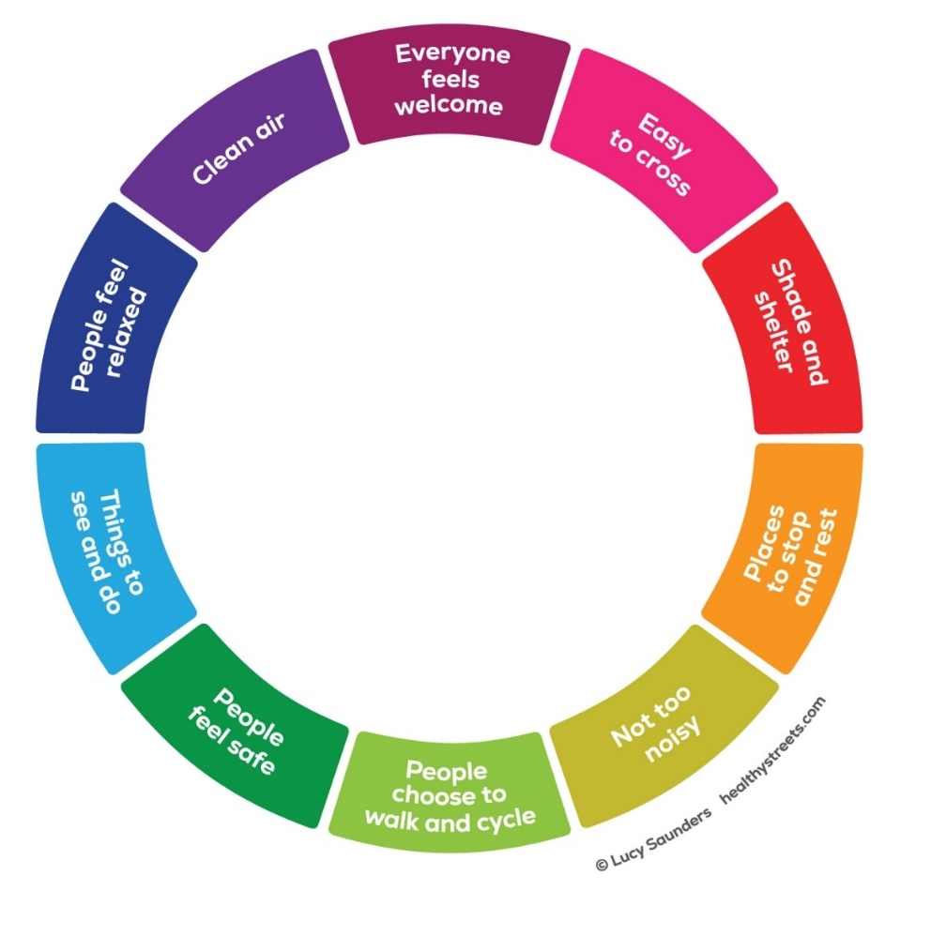
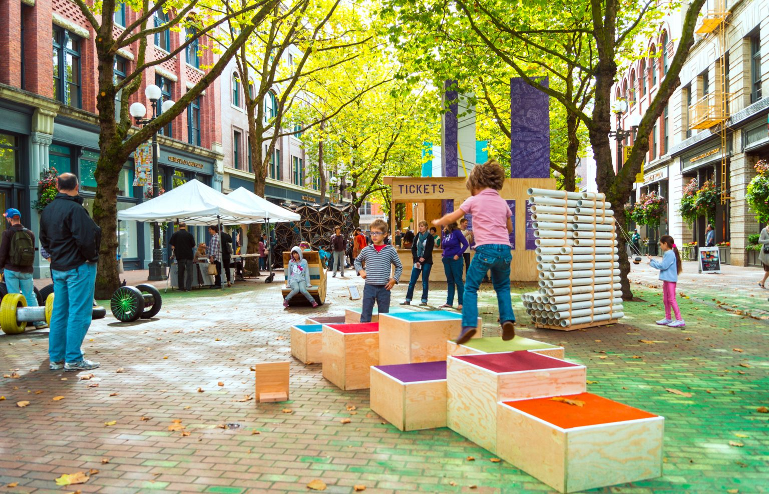
Introduction
Infrastructures under a different perspective
Passage from UR quadrant to UR is possible if:
Formal new roles of the road spaces
Healthy Street model → Policy
bottom-up methodologies: partecipation process through web 2.0 – Crowdsourcing principles → Data harvesting

Slide 6
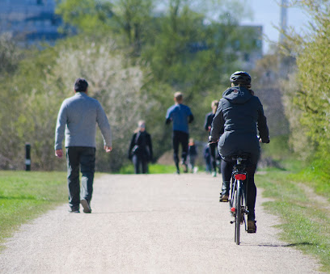
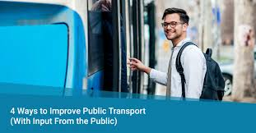

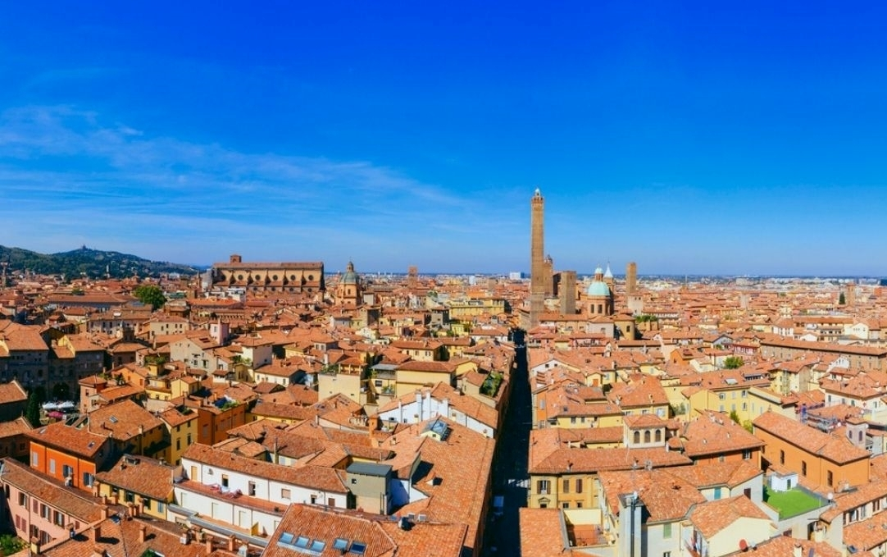

Case study
Urban context
University of Bologna:
Which behavioural and infrastructure issues may address sustainable mobility policies?
How can a shared information create a DSS layer for ecological mobility?
Middle sized historical city
Complex organization
(UniBo)
“The real-time city is real! As layers of networks and digital information blanket urban space, new approaches to the study of the built environment are emerging. The way we describe and understand cities is being radically transformed—as are the tools we use to design them. ”
(MIT Senseable City Lab – Professor Carlo Ratti)

Slide 7
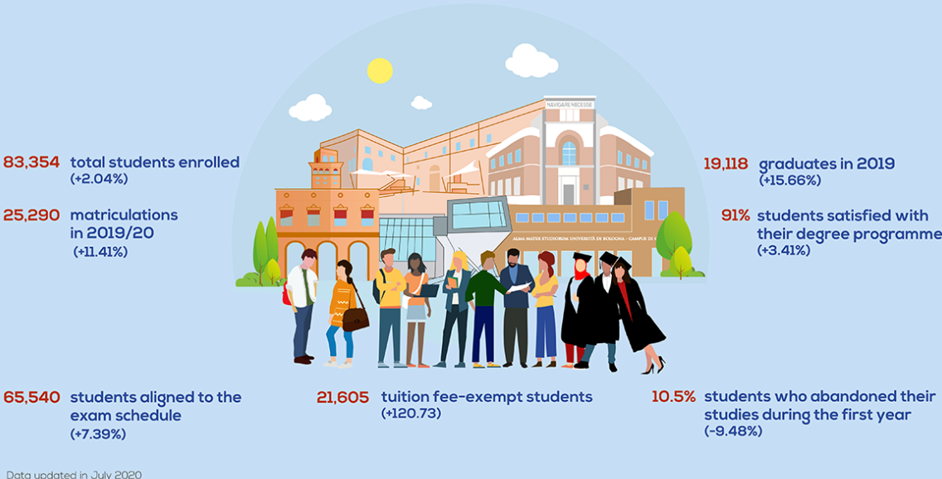
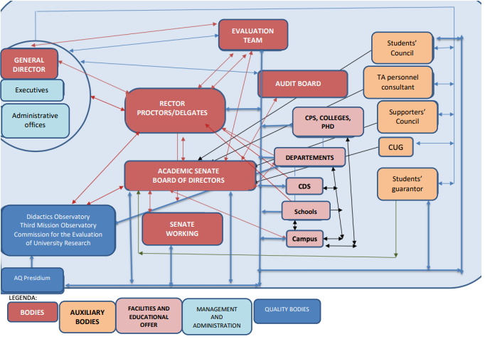
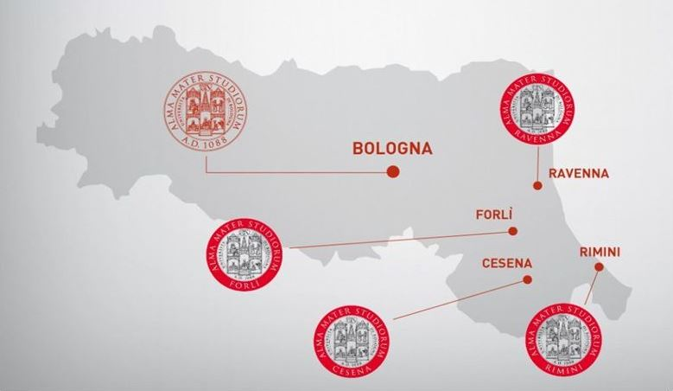
Case study
Complexity on a huge University

Slide 8
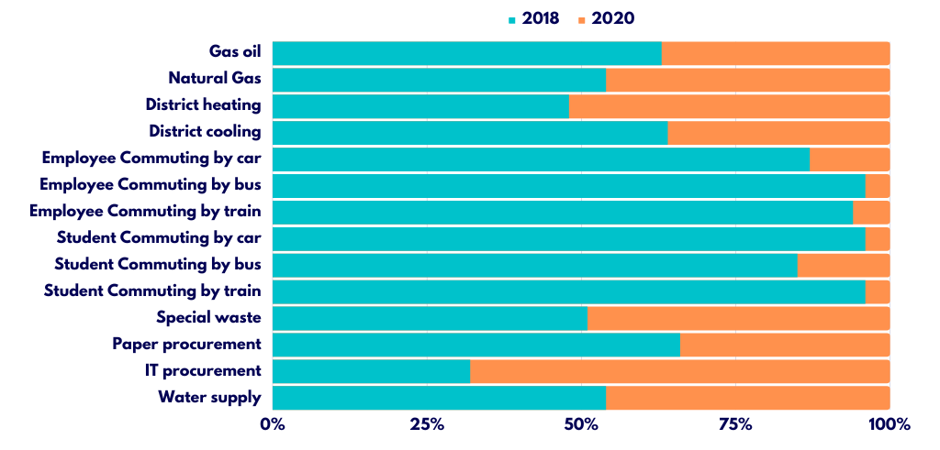
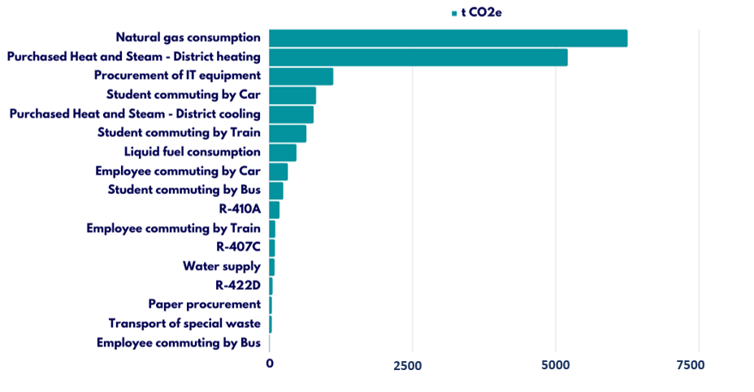
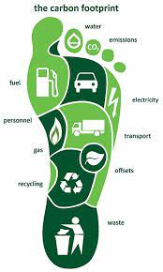
Case study
Impacts
Transportation emissions | tCO2e
Emissions from Home-work commuting - employees | 429
Emissions from Home-work commuting - students | 1,705
Total emissions | 2,143

Slide 9
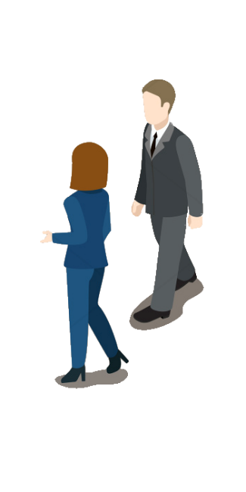

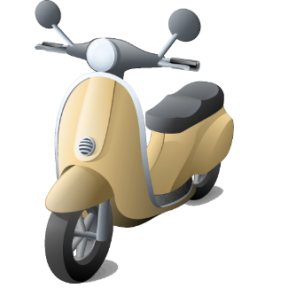
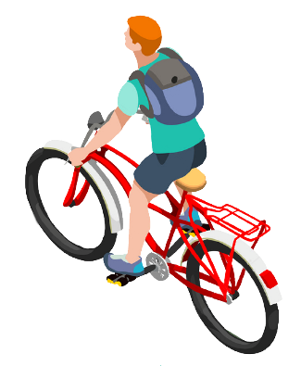
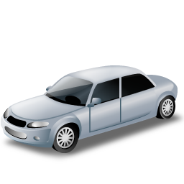
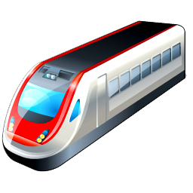

Case study
How do we were used to get to work?
17%
19%
3%
16%
32%
12%
Active sustainable mobility
Sustainable mobility
Unsustainable
34%
50%
16%

Slide 10





Case study
Distance-means correlations

Slide 11
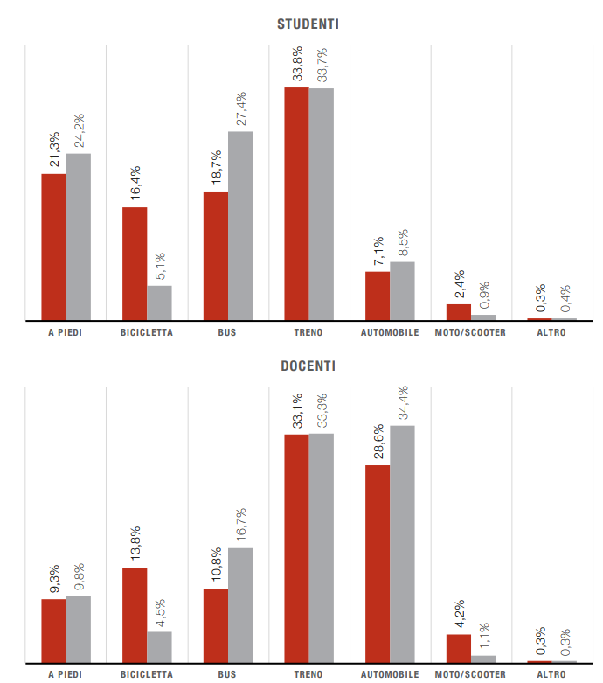
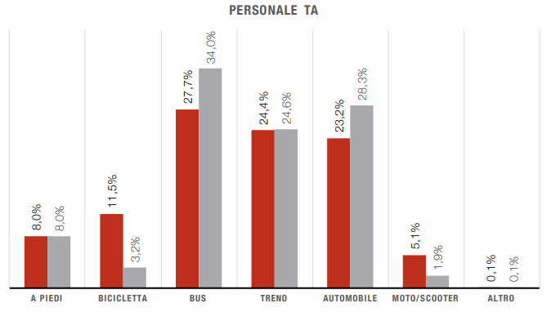
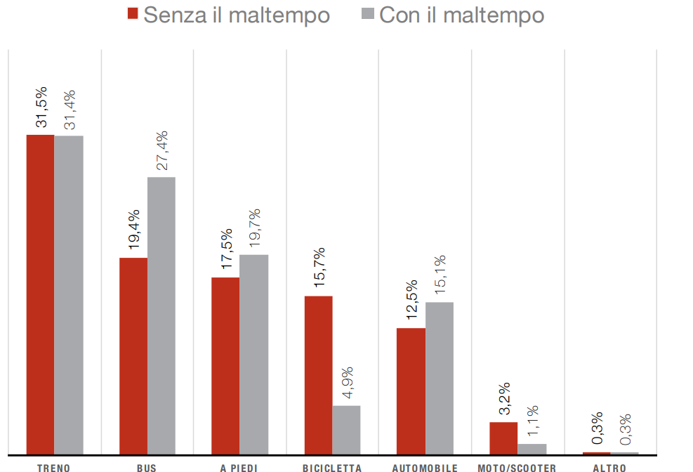
Case Study
Modalshare before COVID-19

Slide 12
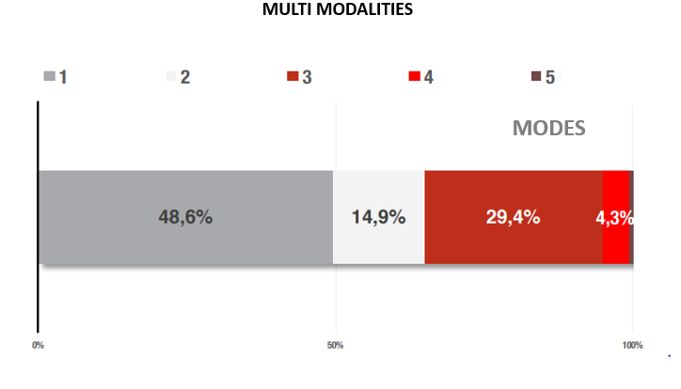
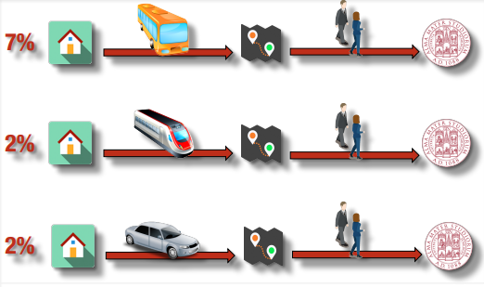
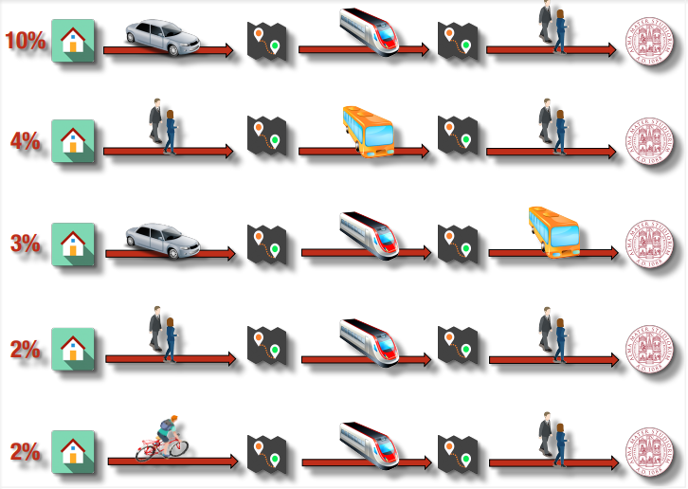
Case Study
Just only one mean?

Slide 13
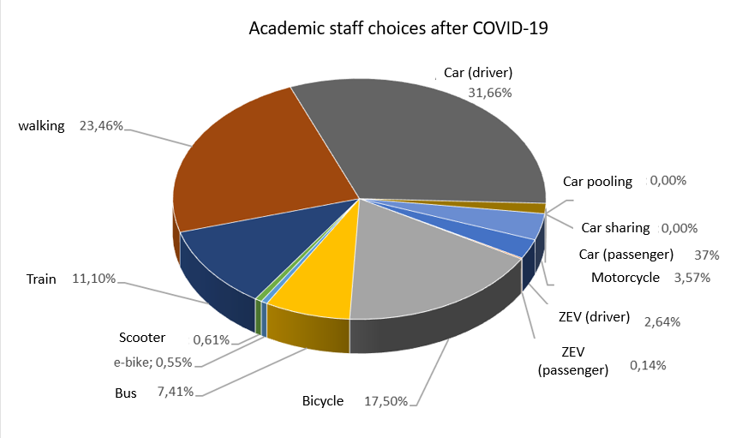
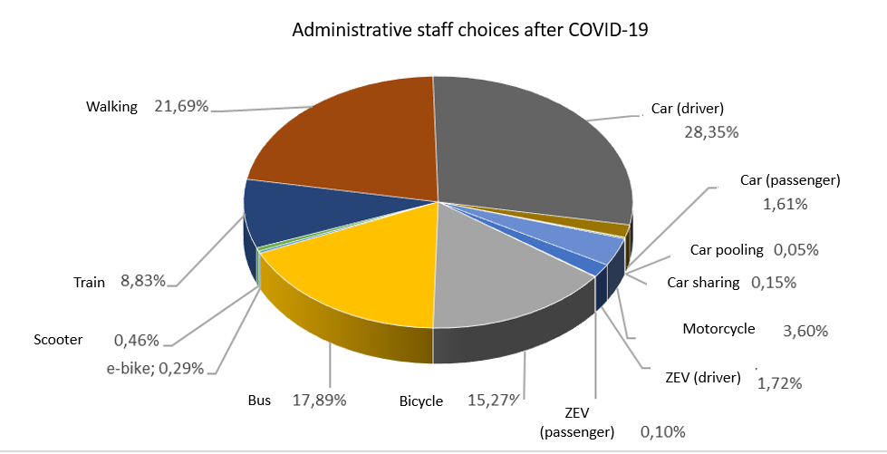
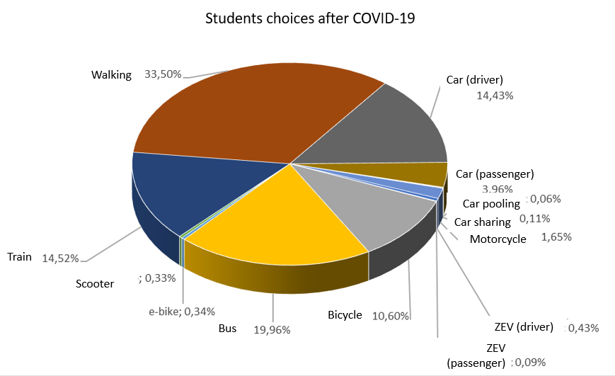
Case Study
Modalshare post COVID-19
Employees:
academic: from 13,8% to 17,5%
administrative: from 11,5% to 15,27%
Students:
from 16,5% to 10,6%
Blended lessons effect

Slide 14
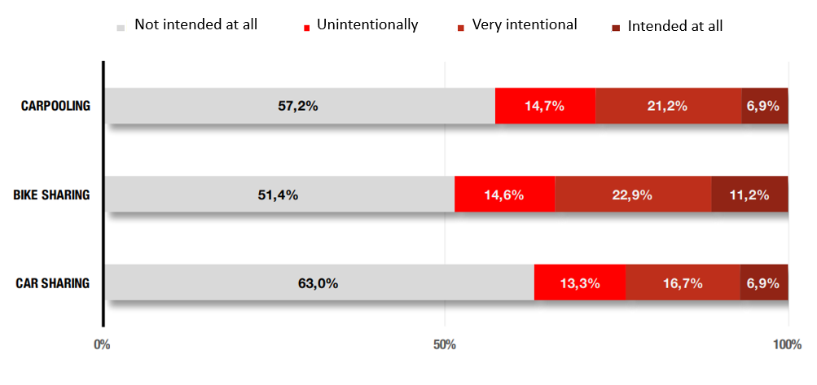
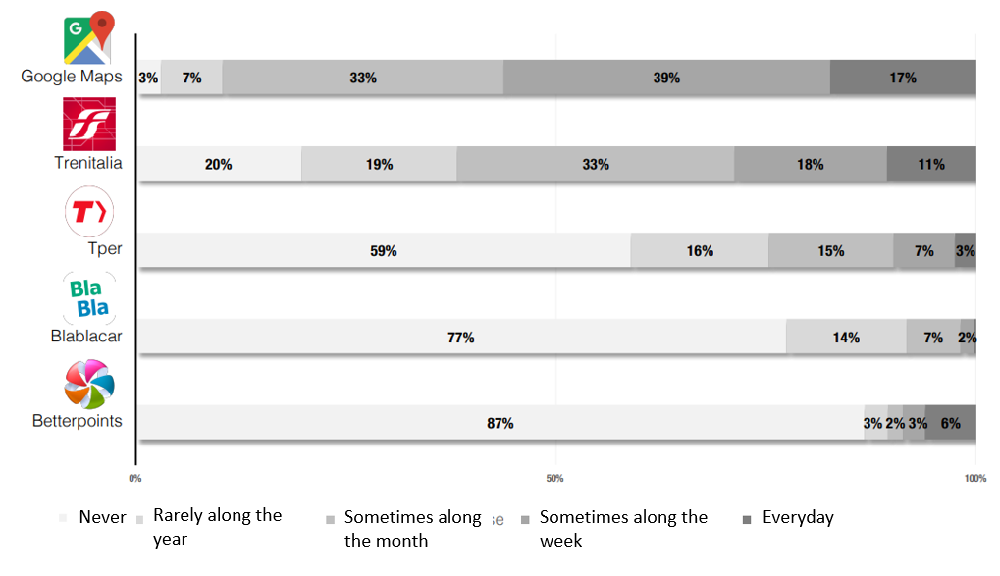
Case Study
Attitudes towards sharing mobility and digital integration

Slide 15
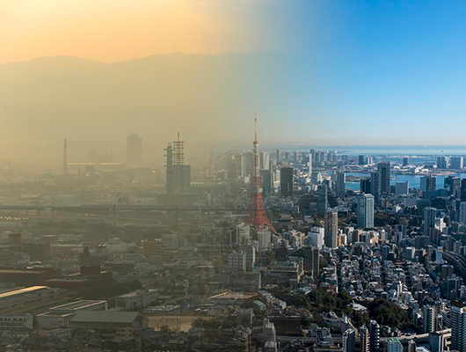
Operations
Through missing links
In light of the rapid global urbanization the links between the built environment and subjective well-being are not sufficiently understood (Mouratidis k.,2021).
Some strategies for understand subjective well-being through urban/infrastructures planning are:
Enhance conditions for active travel
Improve public transport
Measure and interpret air quality
Implement alternative fuels
Almabike
Subsided tickets
Almabike infrastructured
Hybrid electric fleet management

Slide 16
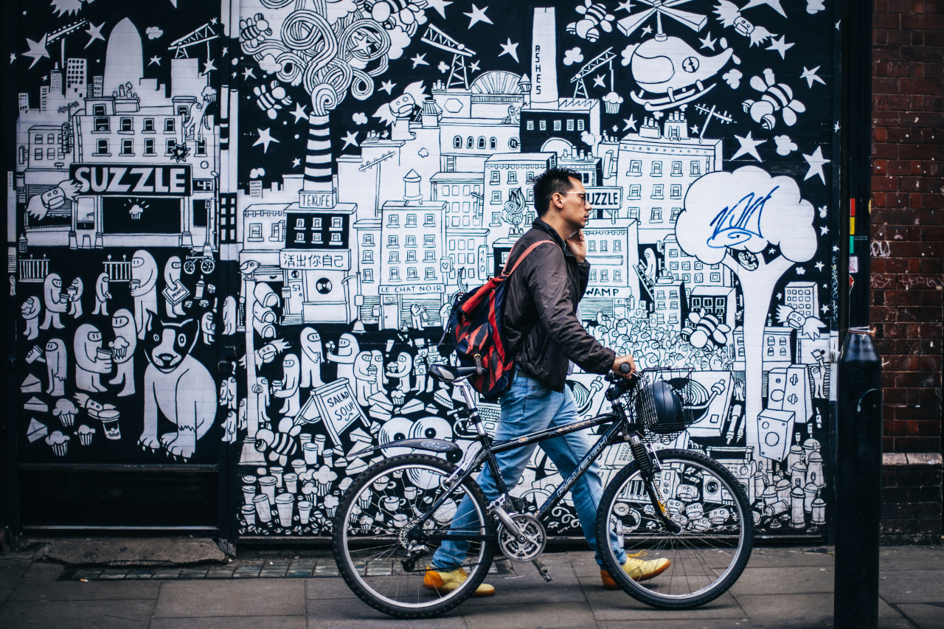
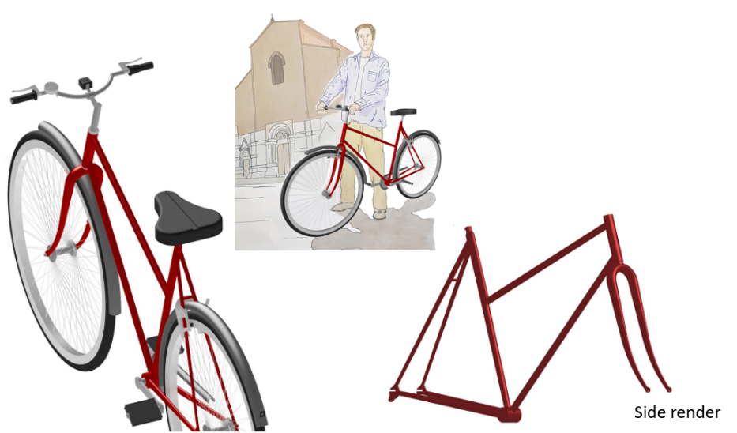
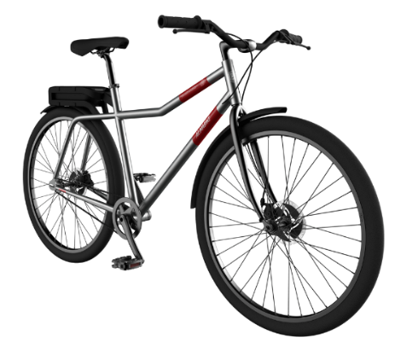
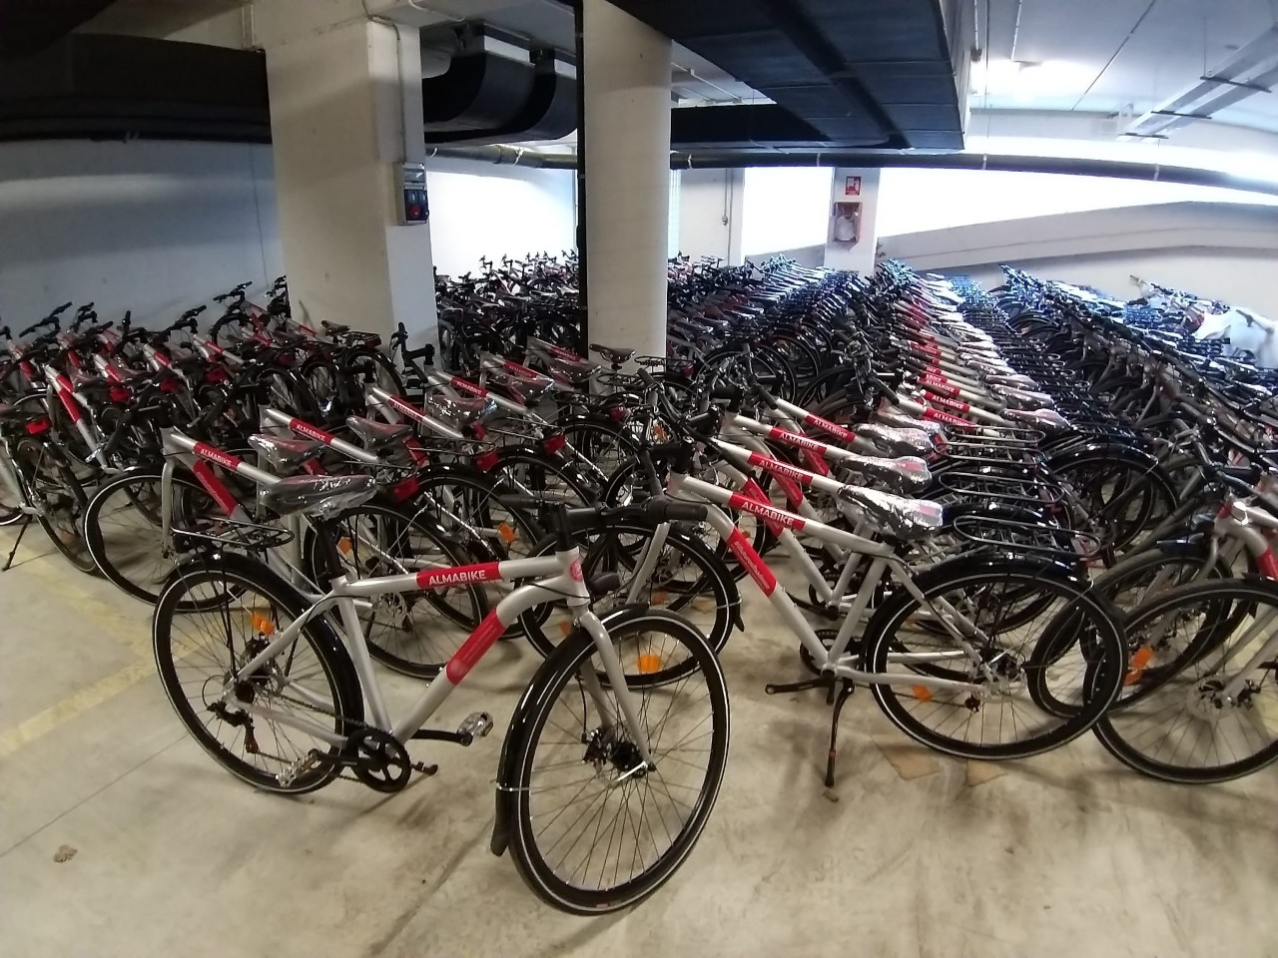
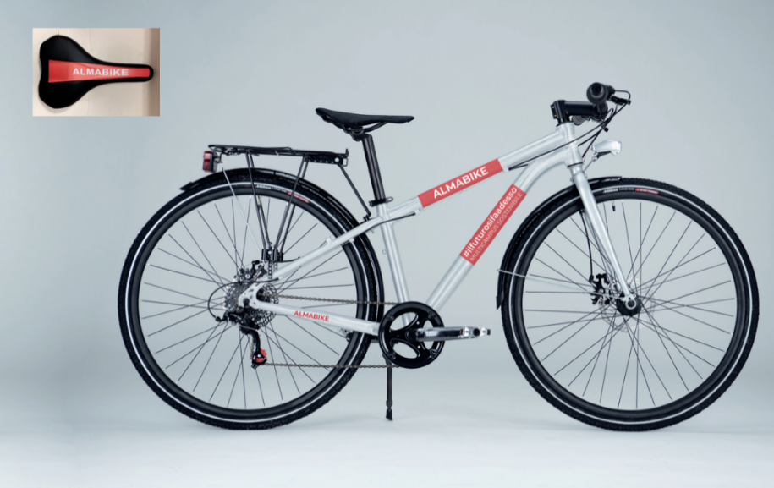
Cycling
Almabike: maps and legends
Student concept
Design development
Production (650)
Prototype
Desired effect on students: improving bicycles images and enhance cycling through middle term sharing

Slide 17
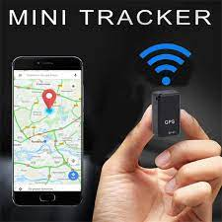

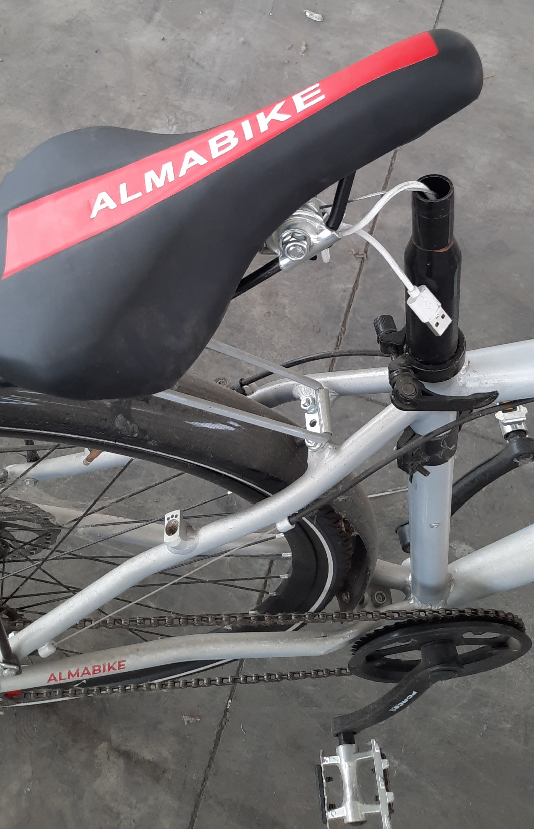
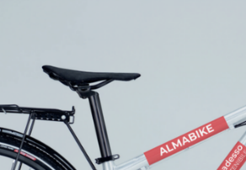
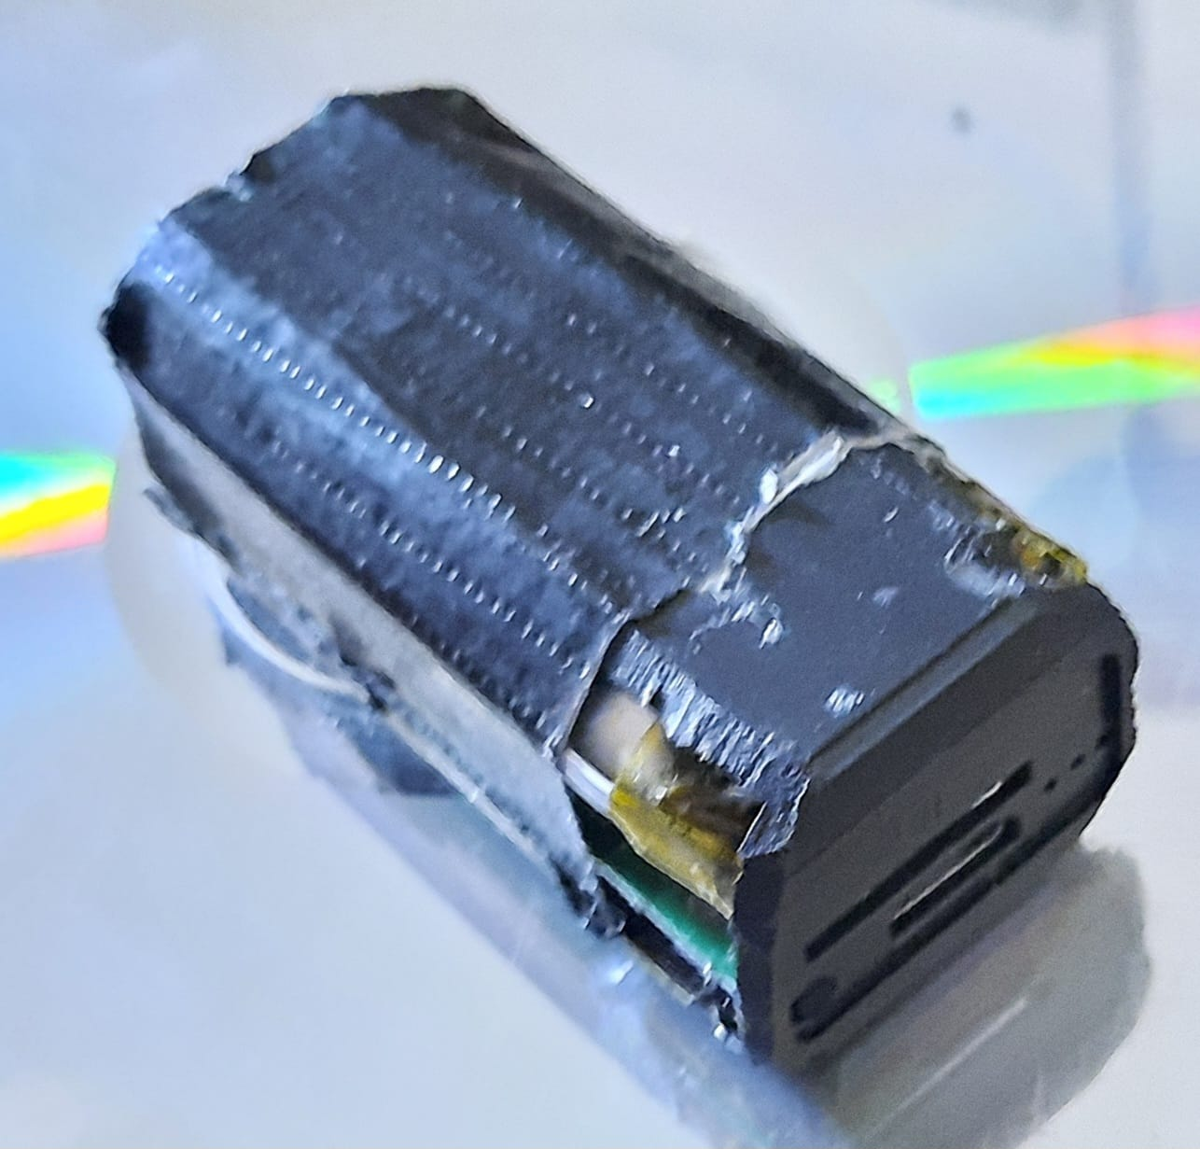
Cycling
Almabike: maps and legends

Slide 18
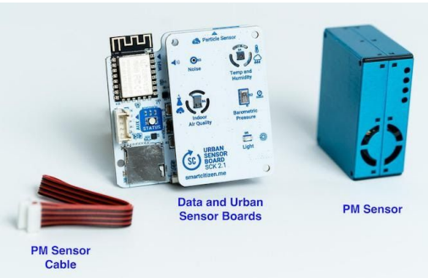
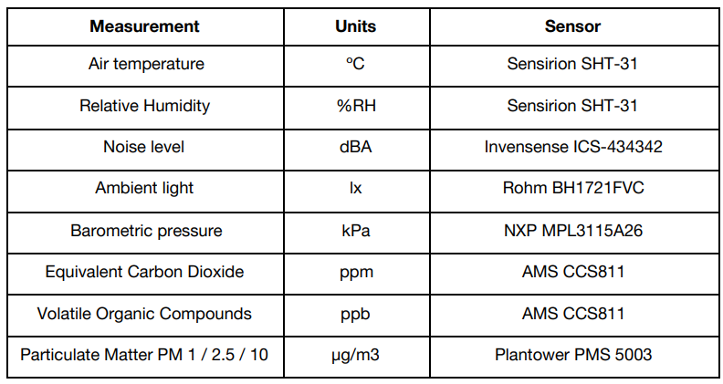
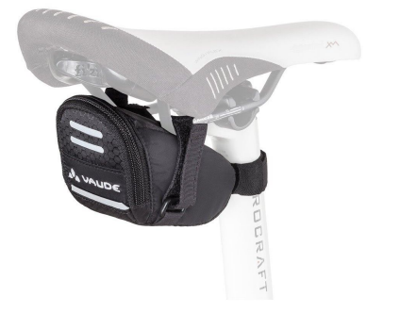
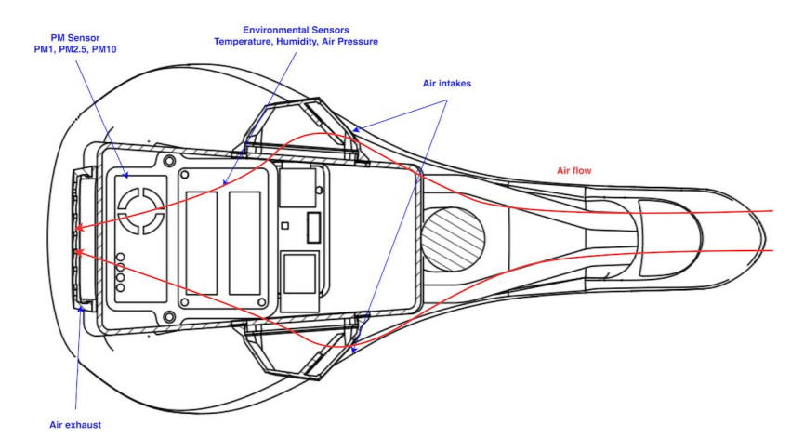
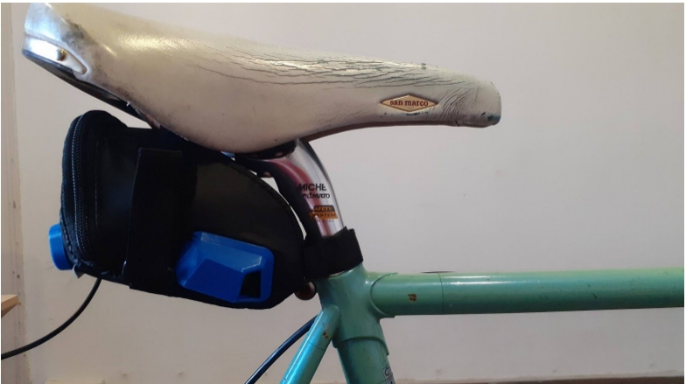
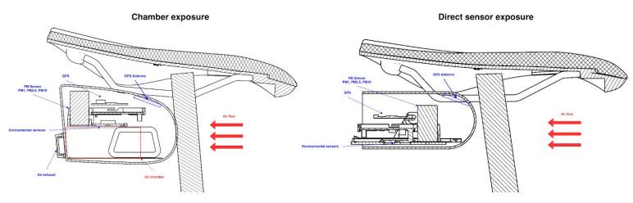
Cycling
Almabike: maps and legends

Slide 19

Cycling
Methodologies
Phases
Phase 0: privacy
Phase I: Bicycles distribution to students
october 2020 – march 2021
About 500 bicycles distributed
(Through a call)
Phase II: Observation
March 2021-july 2021
Phase III: Analysis
September 2021 – november 2021
Data correction and survey

Slide 20



Cycling
Methodologies
Data correction
Analysis
Attitudes on cycling before Almabike
Confidence with the city
COVID-19 impact
Tripping reasons
Satisfaction
Almabike impact
Survey
Cycle path usage

Slide 21

Cycling
Students categorization issues

Slide 22




Cycling
Results
Nessi origine-destinazione

Slide 23

Cycling
Results
Some results from the survey
Only 13% was used to cycling before Almabike .
75% of users rides daily on cyclepaths, while 17% does not use cyclpaths due to the lacki of continuity during home work tripping

Slide 24




Impact of pollution
Environmental issues
http://isi-studio8bis.csr.unibo.it:25122

Slide 25

2021 - 2022
2022 -23
Public Transport
Policy Results
Public transport in Metropolitan area of Bologna
15,711 overall subsided ticket for students, in which:
3,330 tickets for 3,197 students with extra effort,
224 tickets for exchange students
248 subsided ticket for academic staff
1.384 ticket for administrative staff and
731 tickets for PhD students.
Overall expanse: 1,606,826€.
Railway transport in regional area
600 subsided tickets for
Overall expanse: 500,000€

Slide 26

Alternative fuels
Results
Corporate Fleet management
Based upon the shift of paradigm from property usage to sharing use.
Digital booking, recharge hubs
Overall fleet:
57 full electric vehicles, hybrid or bifuel
4 rapid charge station

Slide 27

Alternative fuels
Results
Electric scooter with double break system and speed limitation (DL 121/2021)
Integrated GPS (precision about 3 meters
Scooter fleet: 100

Slide 28

Next phases
To establish a correlations between policy and results on modalshare
To construct a Decision Support system to address green infrastructure for university campuses, exploiting urban factors impacting on environment
To develop new applications able to enhance urban cycling based upon road safety and roads maintenance conditions.
To design new services for cycling (parking infrastructures, cycles support)
To offer new benefit for employees based upon opportunity to recharge private electric cars

Slide 29
Roberto Battistini
ATES – Technical, Constructions and Sustainability Division
DICAM – Department of Civil, Chemical, Environmental, and Materials Engineering
roberto.battistini2@unibo.it

