Slide 1
Luiss & UI GreenMetric
Sustainability@Luiss
7 luglio 2023
Libera Università Internazionale
degli Studi Sociali Guido Carli

Slide 2
Something about Luiss

Slide 3
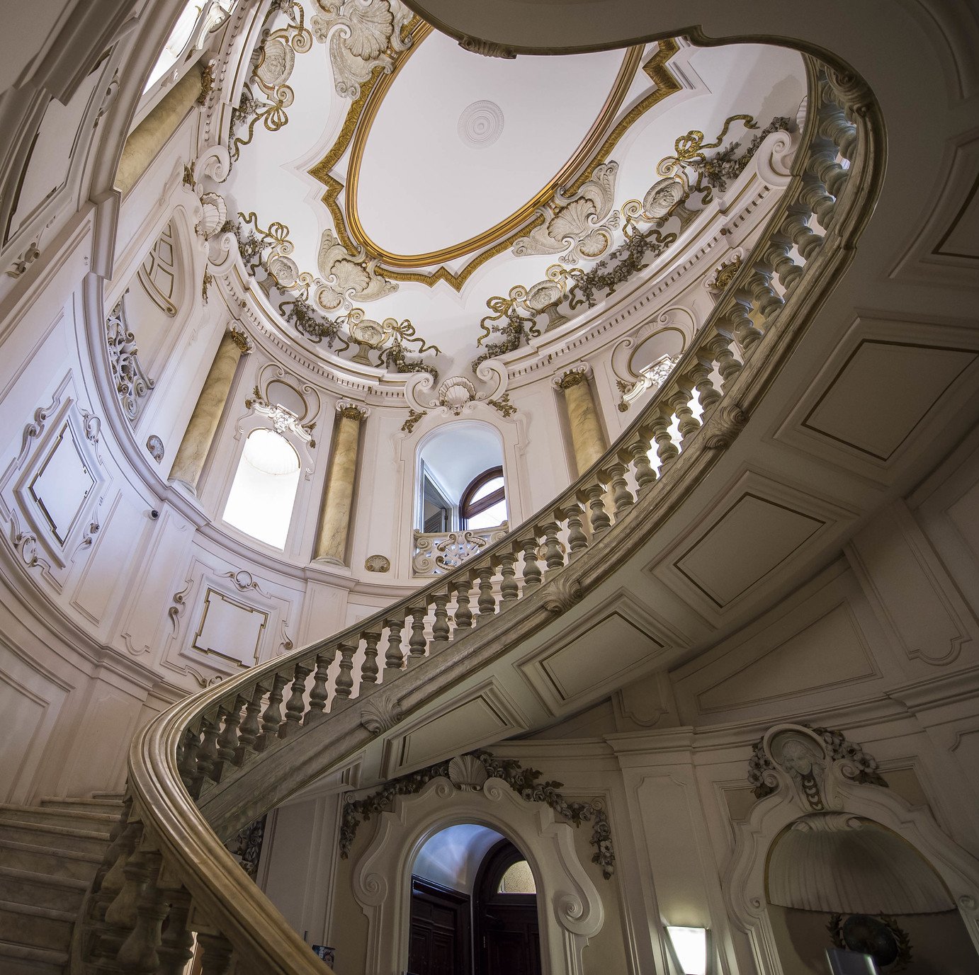

Luiss University
Luiss – Libera Università Internazionale degli Studi Sociali Guido Carli – is an independent university. It was created out of a pre-existing Roman institution, Pro Deo, between 1974 and 1978.
Luiss offers an innovative educational approach – called Enquiry based & education at large - at its four Departments: Economics and Finance, Business and Management, Law, and Political Science. Its goal is not simply to convey knowledge but to instill flexibility in young people, giving them a sense of mastery over their future.
Furthermore, Luiss has four Schools for graduate and professional studies: the Luiss Business School, the School of Government, the School of Law, and the School of European Political Economy.

Slide 4
Luiss in figures
4-16
9.955
1:7
Department and School - buildings
Students, 95% graduated on time
Ratio professor/students
14%
72
10.300.000 €
Scholaships funds
Selection rate for Management e Computer Science
Tutors

Slide 5
UI GreenMetric World University Rankings

Slide 6

GreenMetric – general overview
UI GreenMetric World University Rankings is an annual publication of university rankings on sustainability. It is an initiative from the University of Indonesia that ranks universities around the world based on their commitment and actions towards sustainability. UI GreenMetric World University Rankings aims to increase university awareness towards sustainability since 2010.
UI GreenMetric collects data through an online questionnaire. All participants complete the questionnaire with evidence. After that, UI GreenMetric expert members and reviewers validate the answers based on the evidence that participants provide.

Slide 7
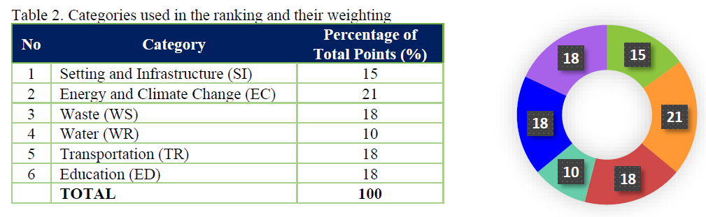
GreenMetric – general overview
6 categories, every category has a weight, and within each category specific indicators have specific points.

Slide 8
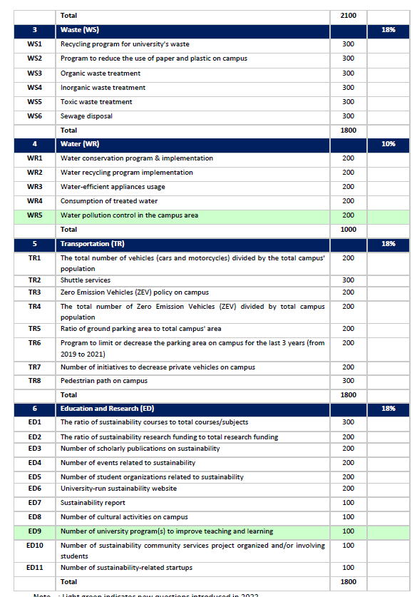
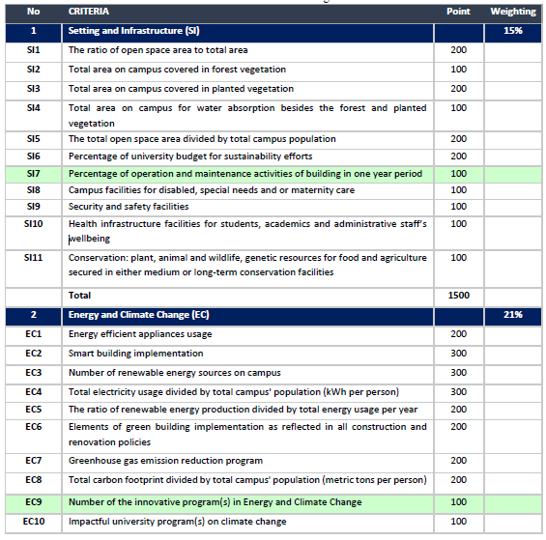
GreenMetric general overview

Slide 9

Some broader points
Given the way data are to be sent and the discretion of some scores, there is a lot of uncertainty. Sometimes, for the same evidence we got different scores
Moreover, in some cases we have no evidence of how data are considered in relation to the specificity of the University (eg climate change programs: how is it related to the Departments that a University have?)
How do they validate the data and information?
Sometimes indicators change so there is no perfect comparability between one year and another

Slide 10
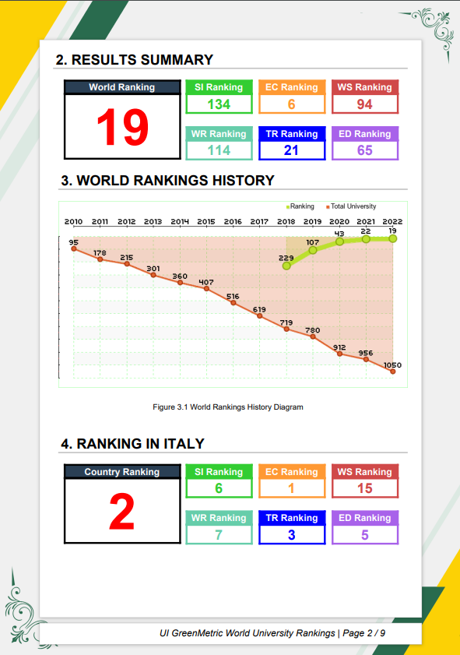
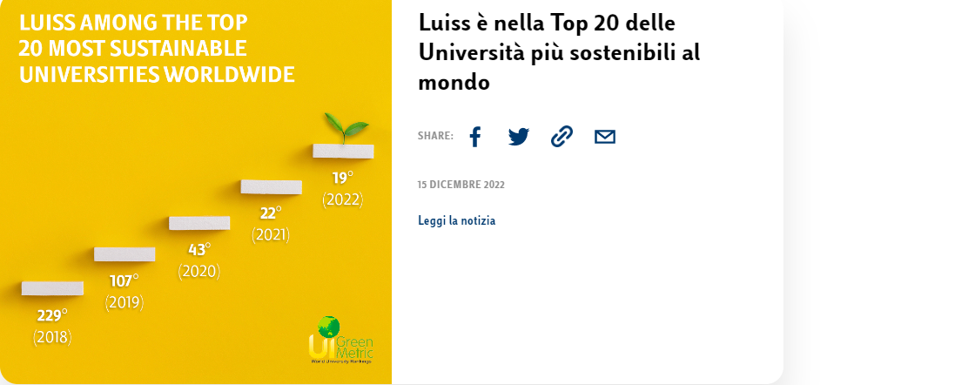
Our performance
Our first application was in 2018 (719 total applicants). Last year we were 19 out of 1050 applicants

Slide 11
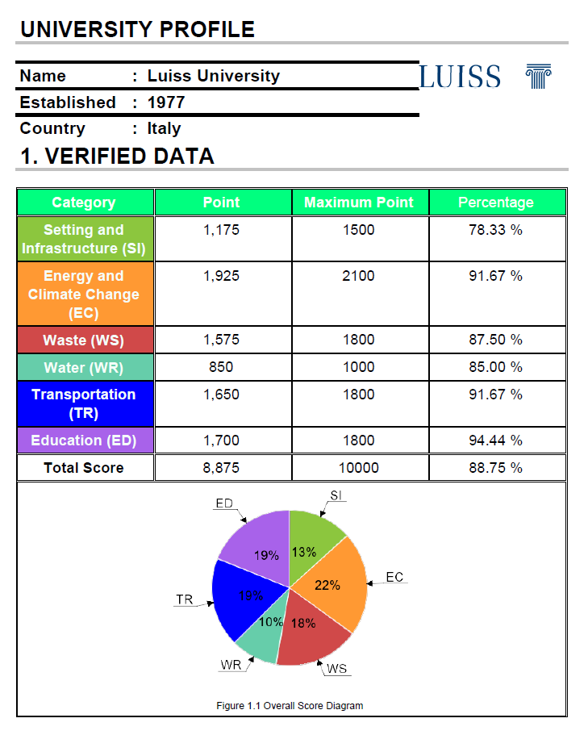
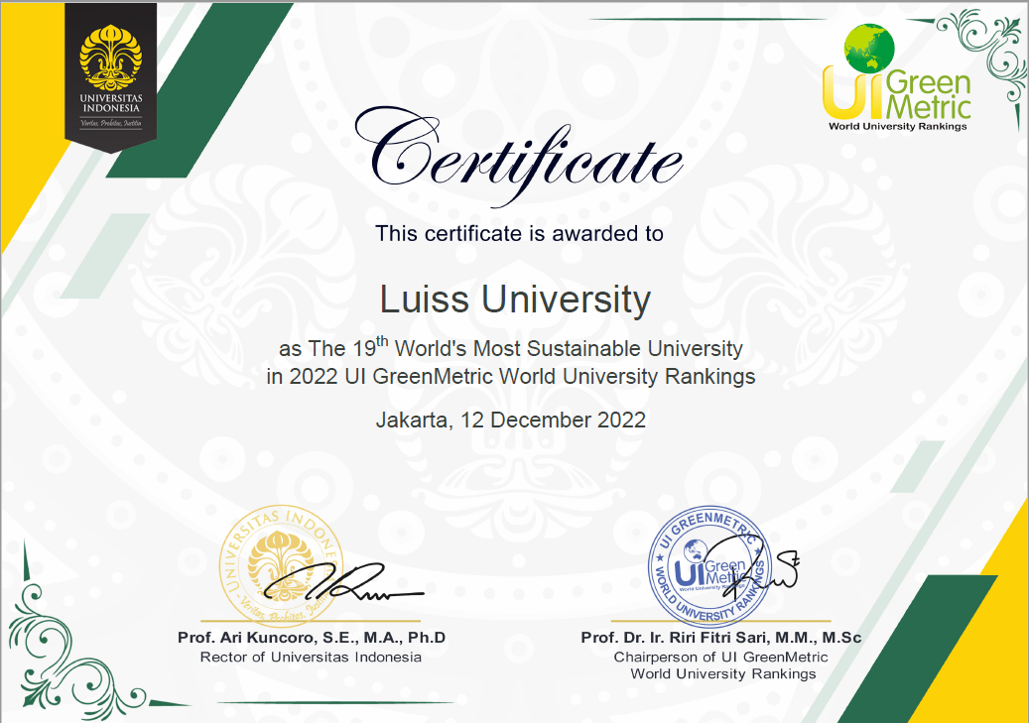
Our performance

Slide 12
Our performance
We have improved in
Setting and infrastructure (new building with the LEED Platinum certification; compensation projects; medical hub; new programs with Legambiente)
Energy and climate change (carbon footprint reduction; compensation measures)
Education (publications, sustainability student organizations, sustainability website)

Slide 13
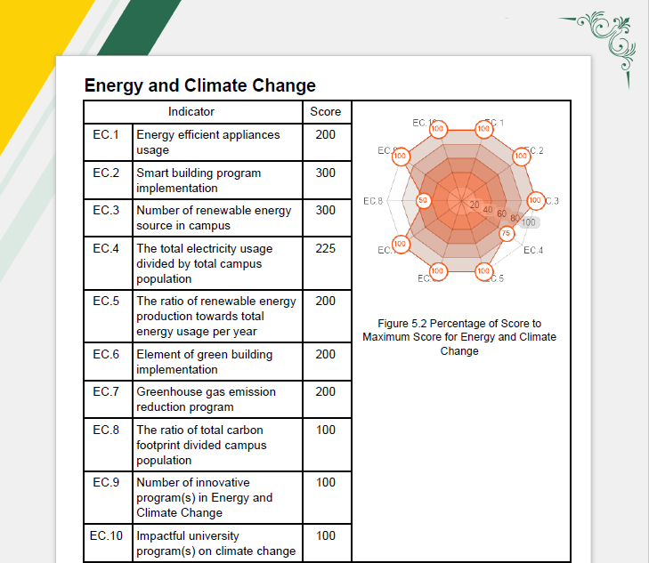
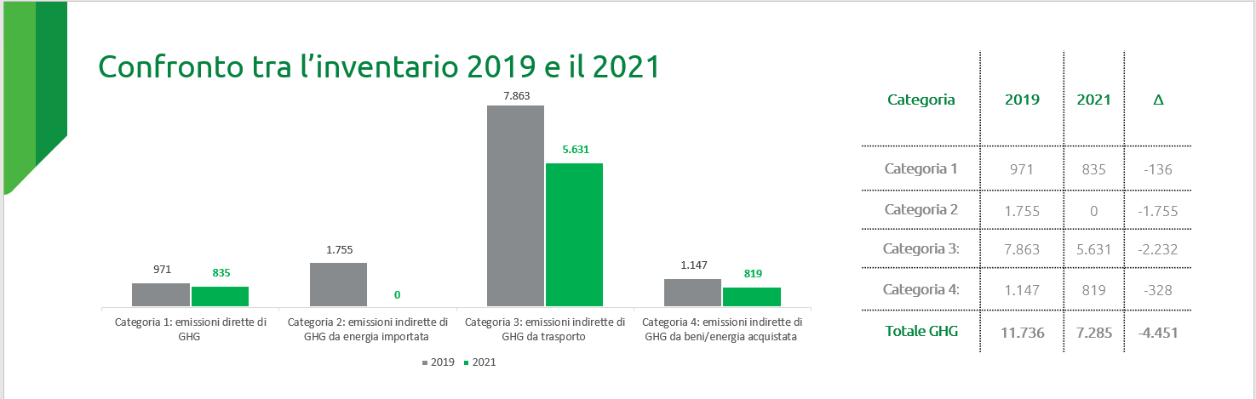
Focus on Energy and Climate Change
We reduced our carbon footprint (2021 vs baseline 2019)
We bought carbon credits to compensate scope 1 emissions for 2023 and 2024
100% energy from renewable sources
100% smart buildings

Slide 14
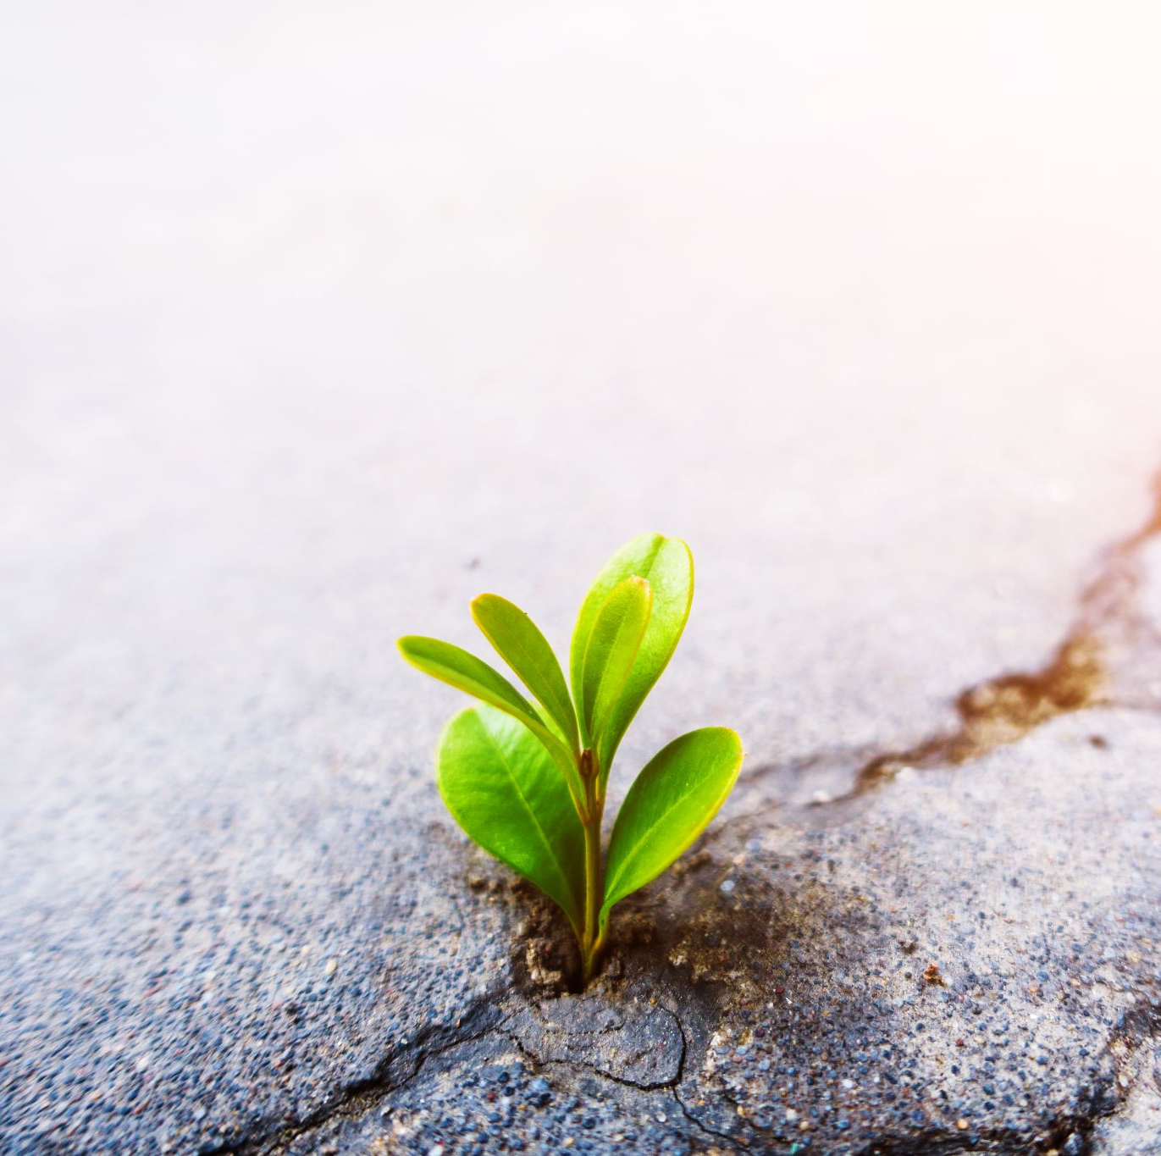
How we did it?
We have provided more evidence over years
A lot of difference is made by the way you’re able to “tell the story”: pictures, websites, texts and presentations
We have improved our website, with a specific section about our contribution to SDGs
We improved our capacity to monitor projects within the University
We have added new programs and projects
Carbon compensation
New building
More energy efficient applies usage (water and energy)

Slide 15
Sustainability@Luiss

Slide 16
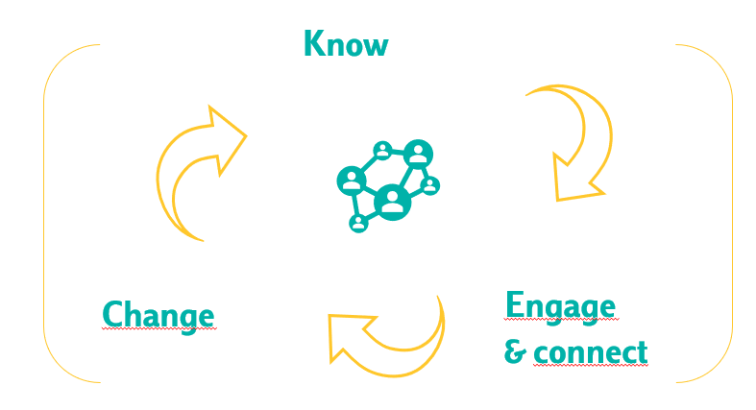
The Purpose & the Strategy
We envision a future in which sustainability – environmental, social and economic - is perfectly integrated into the University and directs every choice and action.
…How? Working together with all the other departments to build and foster a culture of sustainability.
We have engaged our internal stakeholders trough:
Working groups
Surveys and focus groups
Specific communication initiatives with Internal Communication Office
Students activities
Events

Slide 17
ESG Office: an holistic approach
ESG office serves as an hub that designs the strategy, connects different departments, promotes new projects
Know
Research and didactics
Connect
Interraleted projects with a program management perspective
Different Departments on specific task
Develop
Events
Integrated communication plan
KPI
New projects
Engage
New partnership
Integrated Report
What’s going on about sustainability in the University
Our office is:
Owner of new projects
Facilitator of cross-office projects
Pivot of data
Gather external opportunities

Slide 18
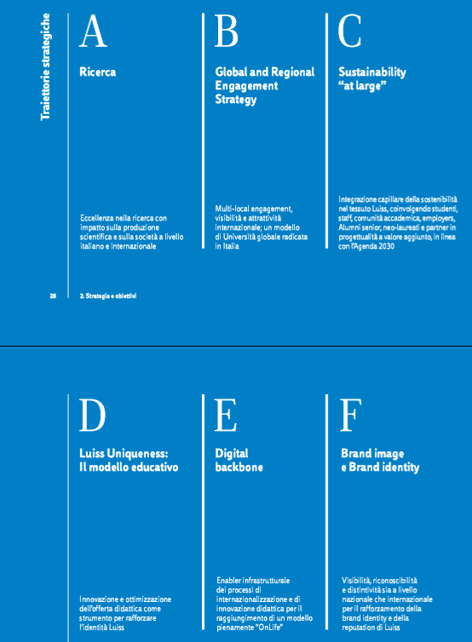
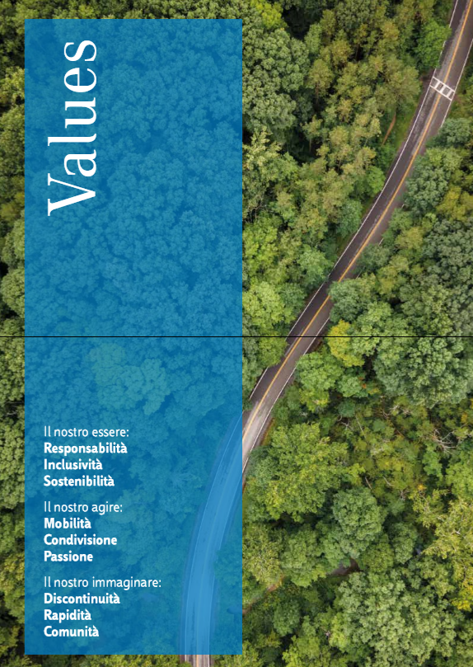
Luiss Strategic Plan
It’s important to have a clear strategy.
In Luiss, Sustainability is perfectly embedded in the Strategic Plan: it’s one of the six strategic trajectories.

Slide 19
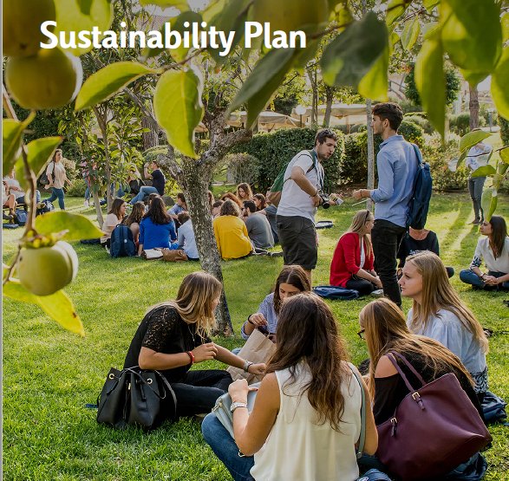
Sustainability Plan
Moving from Luiss Strategic Plan, the Sustainability Plan identifies Vision, Mission, Values and Governance and provides 5 areas of intervention, each of which is associated with specific goals. The sixth area, Diversity & Inclusion, is transversal to the other 5 and guides their objectives and actions.
Teaching - Student learning and experiences
Faculty Scientific Research
Facilities & campus operations
People & Culture
Communication & Engagement
Diversity & Inclusion

Slide 20

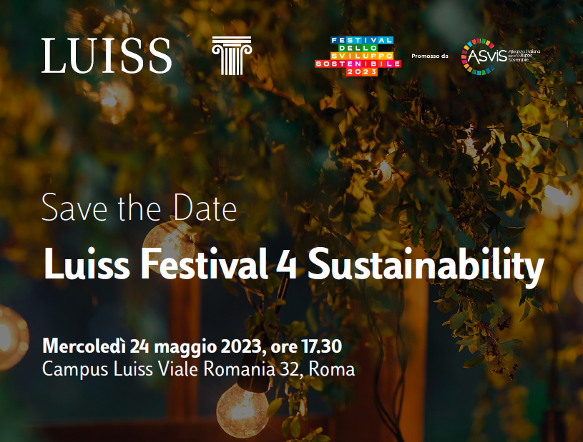

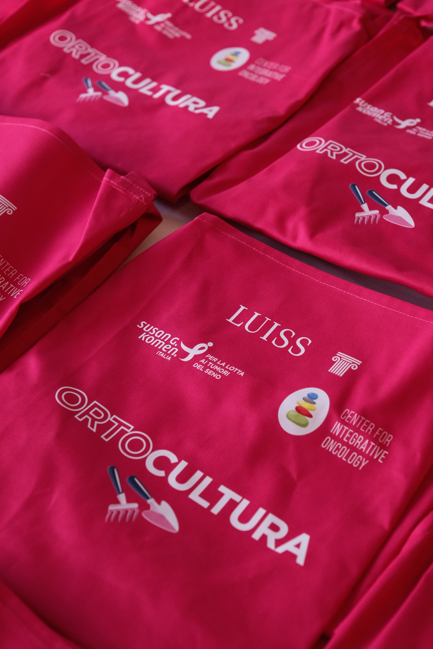
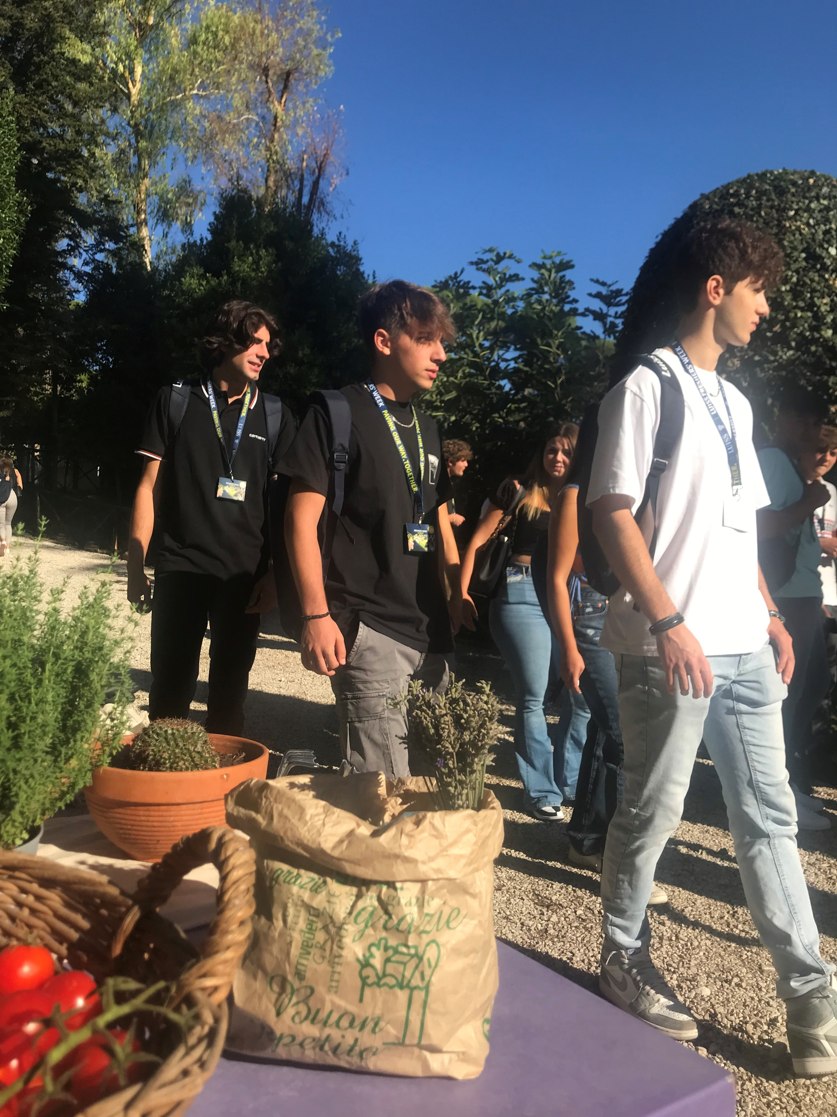

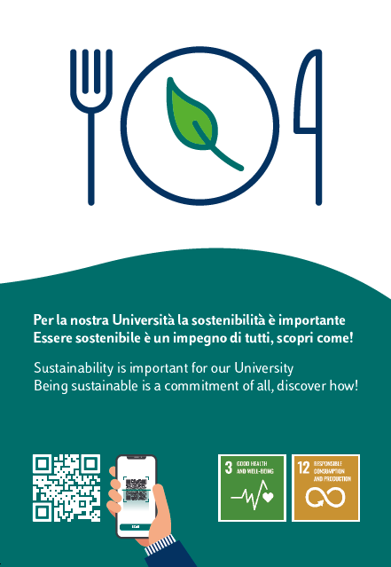
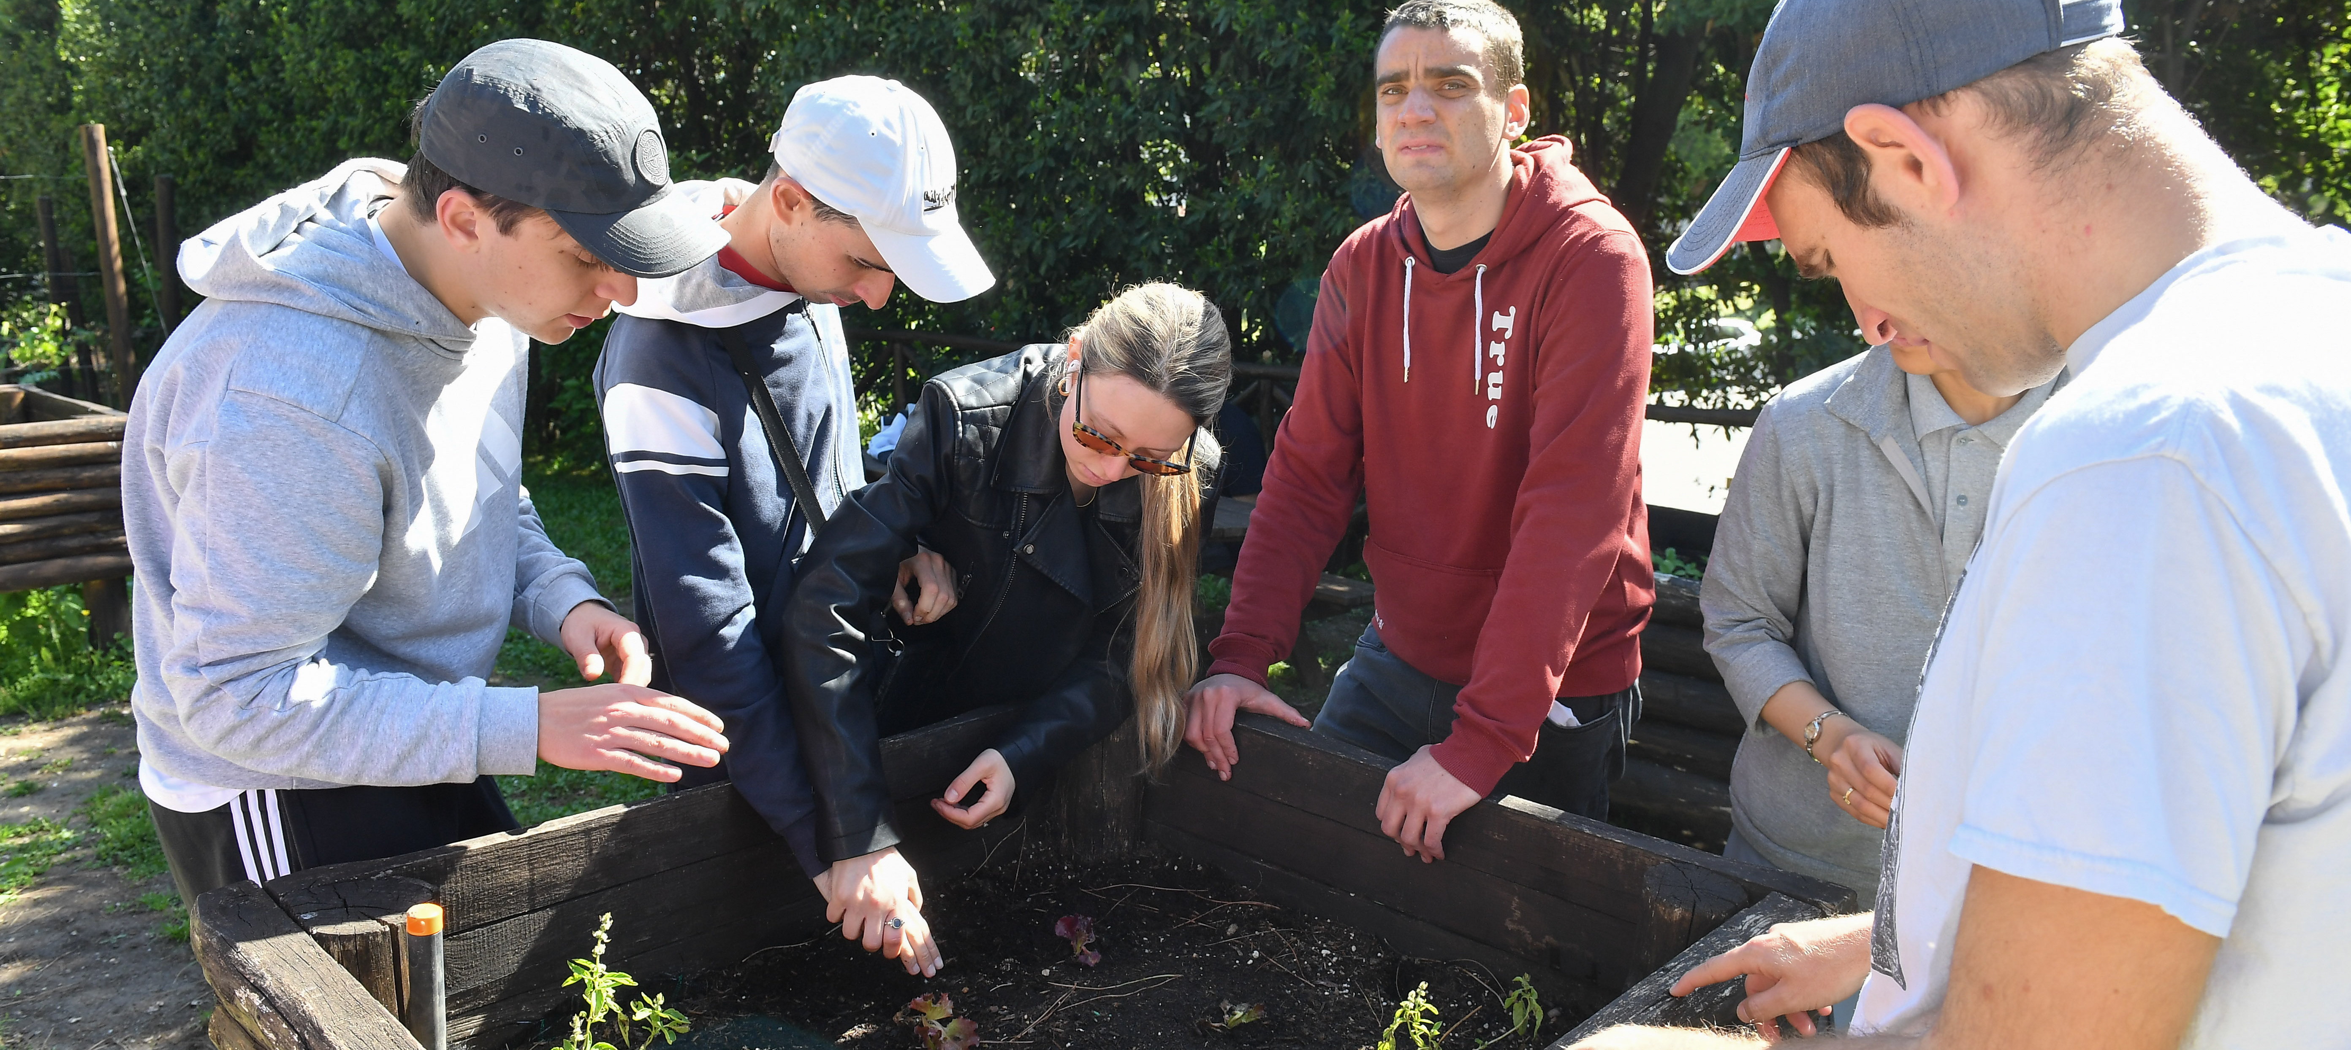

How do we work?
We work in two main directions:
Every year we conduct a survey asking every office what they did about sustainability
Sustainability KPIs
Looking at rankings, SDGs targets, GRI standards, and according to our Sustainability Plan, we work with colleagues from other departments to run projects

Slide 21

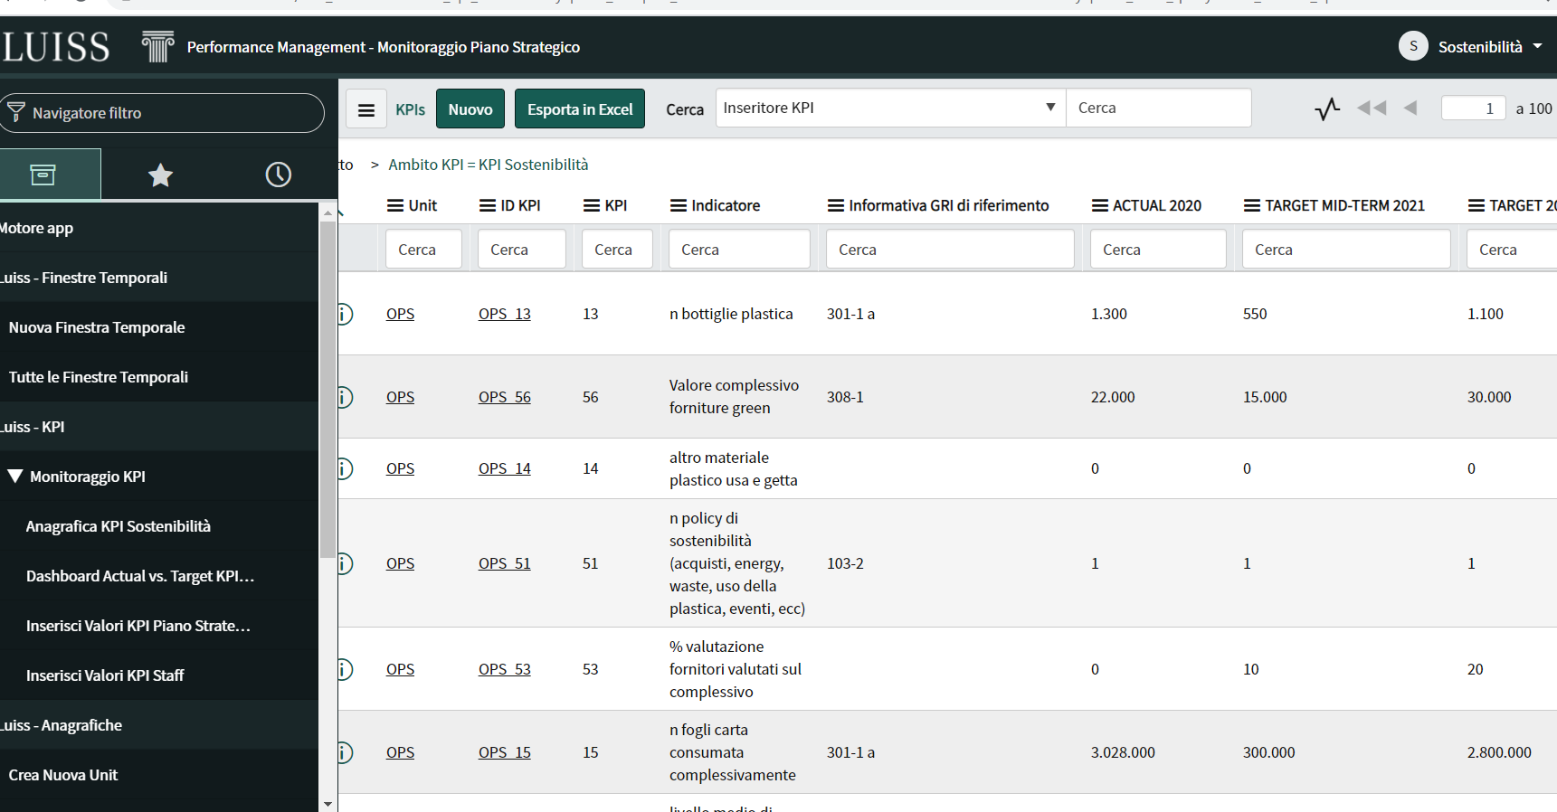
Focus on: Sustainability KPIs
Starting from the Agenda 2030, the 6 pillars of our Sustainability Plan and the GRI standards, we identified a set of more than 200 performance indicators to monitor and improve our performances.
Some indicators are part of the general performance monitoring system of the University.
In addition, a section dedicated to Sustainability has been developed in the University’s monitoring platform.

Slide 22
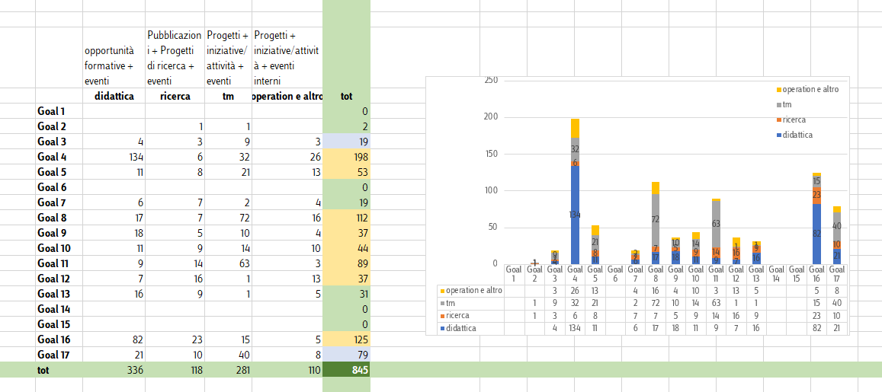
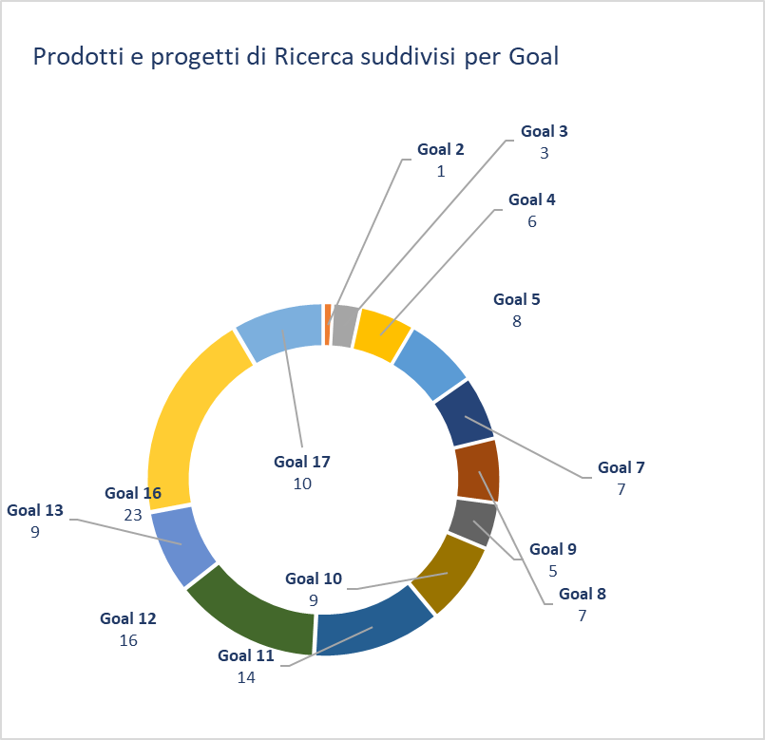
Not only KPIs
We monitor all the activities related to Agenda 2030, so we perfectly know how many projects, courses, research product we have every year for each SDG.

Slide 23
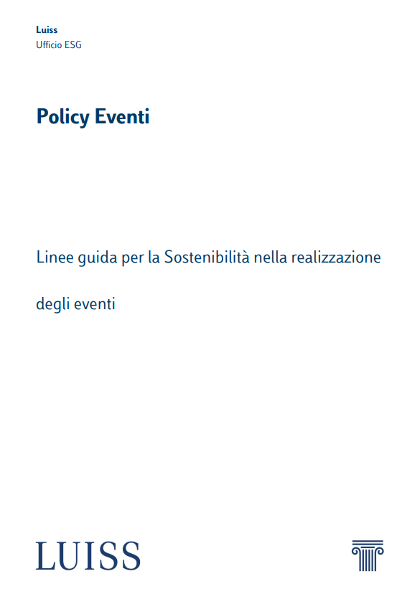
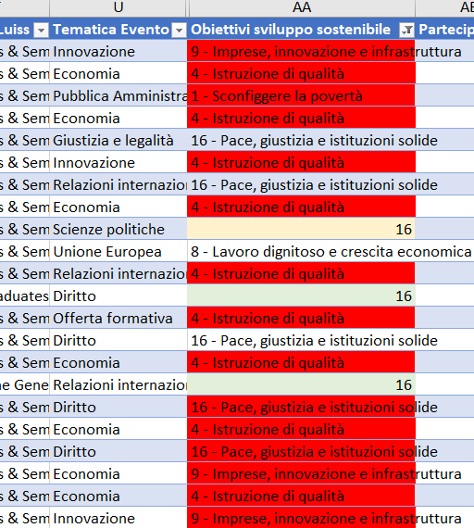
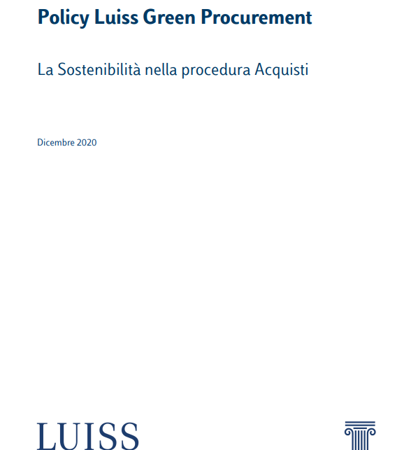
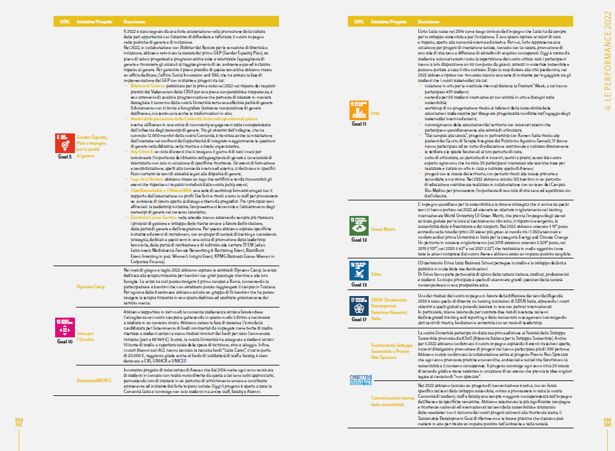
Implementing policies
We turn our Policies into processes and we improved our IT infrastructure to monitor them.
For instance, we changed our CRM in order to monitor the exact number of events SDGs related, and to map how many events follows our Events policy ragarding gender balance, food and gadgets, etc.
We did the same with our IT Procurement tool.
The awareness of what we do (quantitative and qualitative) is the basis for our Integrated Report.

Slide 24
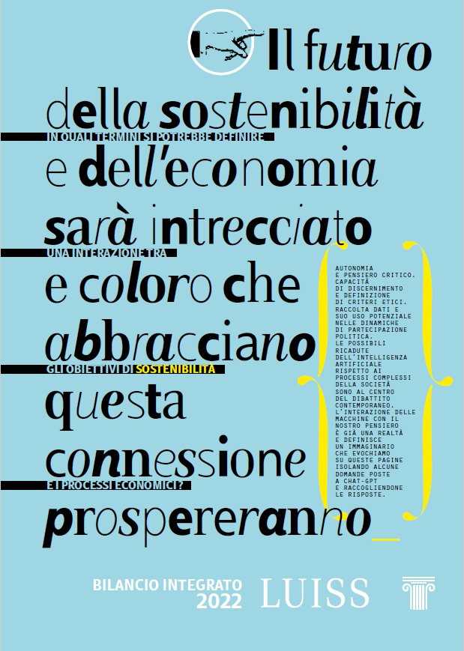
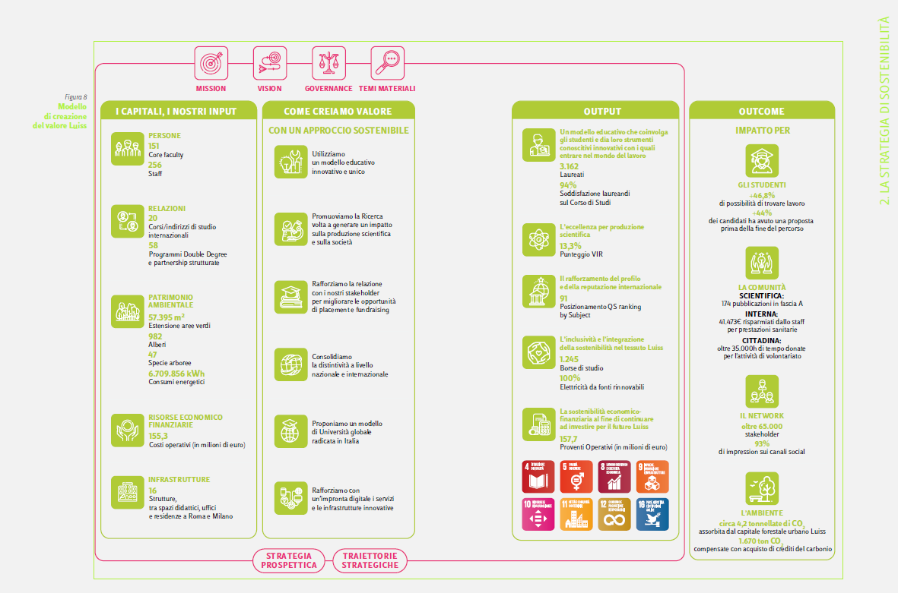

Integrated Report & integrated mindset
In 2020 we drafted the first Luiss Integrated Report, a frontier project through which we have enhanced how our resources and relationships, that are our main assets, has been integrated to create value in the short, medium and long term in favor of the main stakeholders, to realize our «Purposeful Leadership». Thank to our Integrated Report, we embraced and integrated mindset focused on impact.

Slide 25
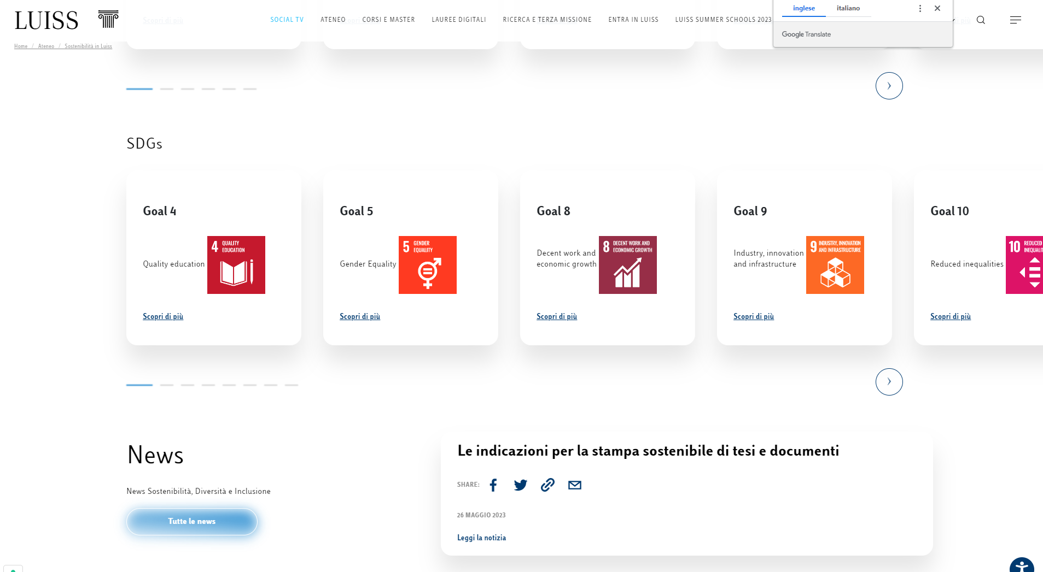
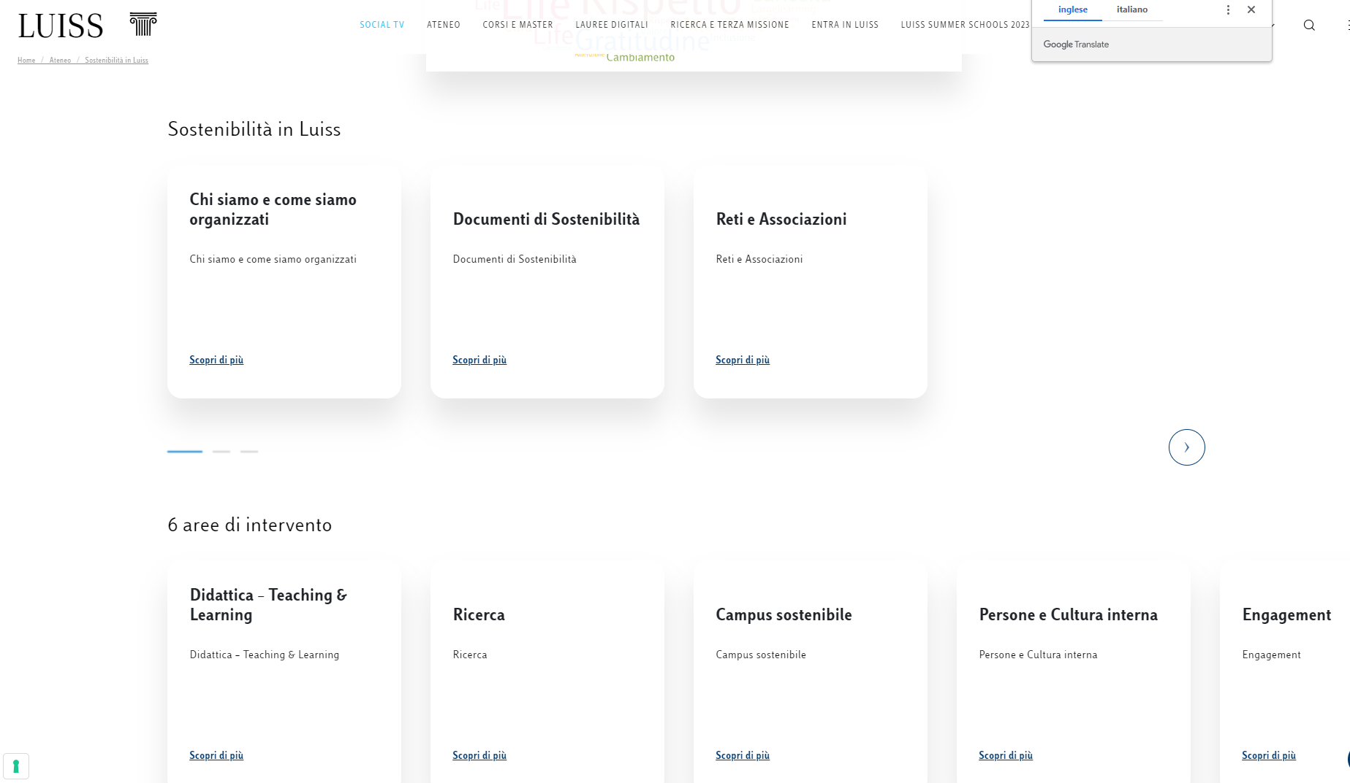
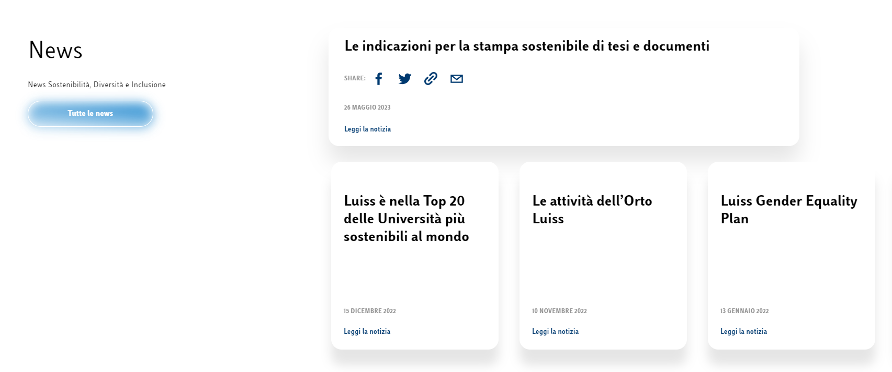

Communication
We developed the Sustainability website following the Luiss Sustainability Plan, with a specific section dedicated to our concrete effort toward SDGs.
This is more than helpful to provide evidences.
Our website

Slide 26
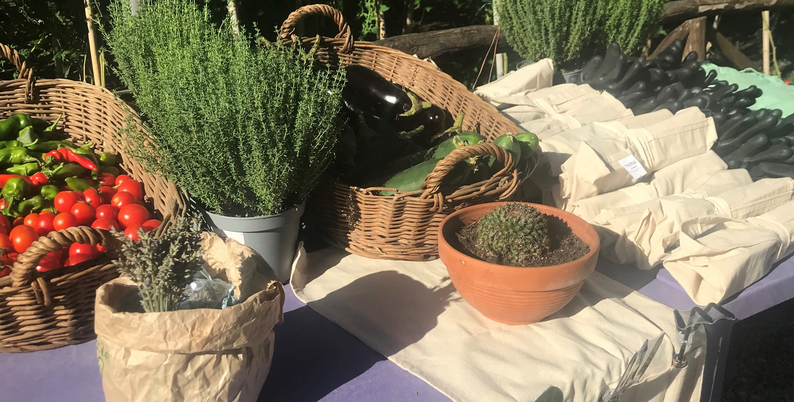
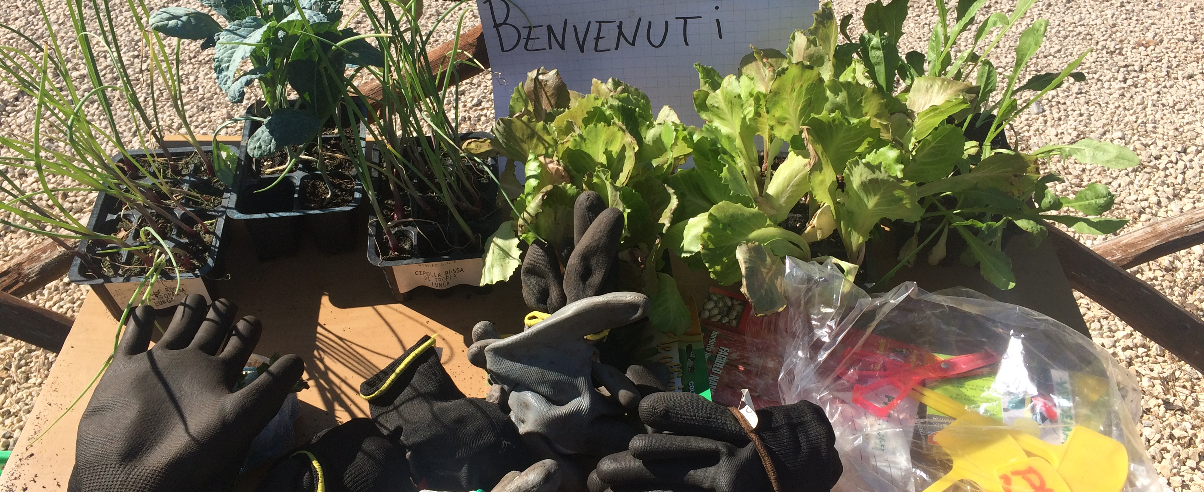
What’s going on
Thanks to this integrated and stakeholder oriented approach, and with the purpose to improve our performance in sustainability rankings, we’re now engaged in many different projects. Just to mention the main ones:
Waste management – a better implementation
An integrated communication plan
A consumption reduction campaign
Food donation initiatives
Paper consumption reduction
New projects around the vegetable garden
New merchandising

Slide 27
Thank you! sustainability@luiss.it

