Slide 1
Sustainability a Journey
Gavin Scott
Head of Sustainability

Slide 2
What we’ll cover today
www.nottingham.ac.uk/sustainability
A little about Nottingham and our journey
The UI GreenMetric
The next steps

Slide 3
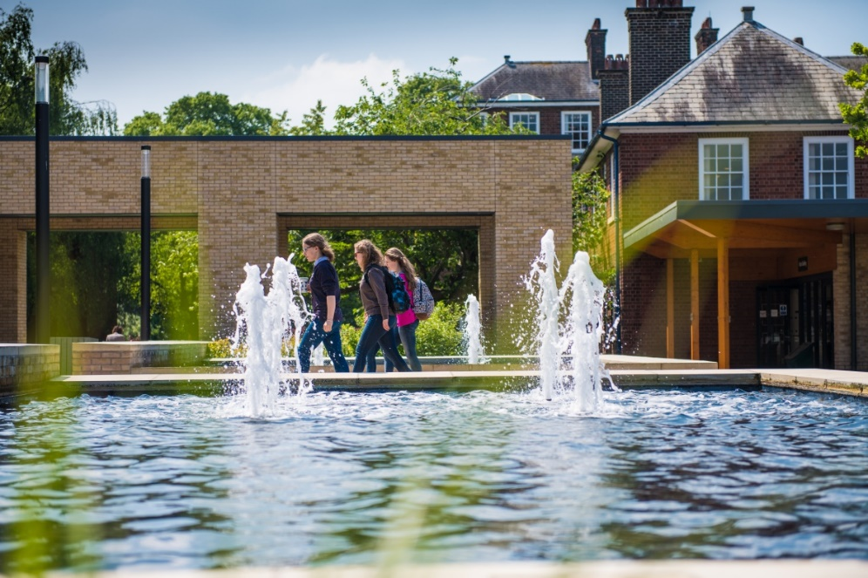
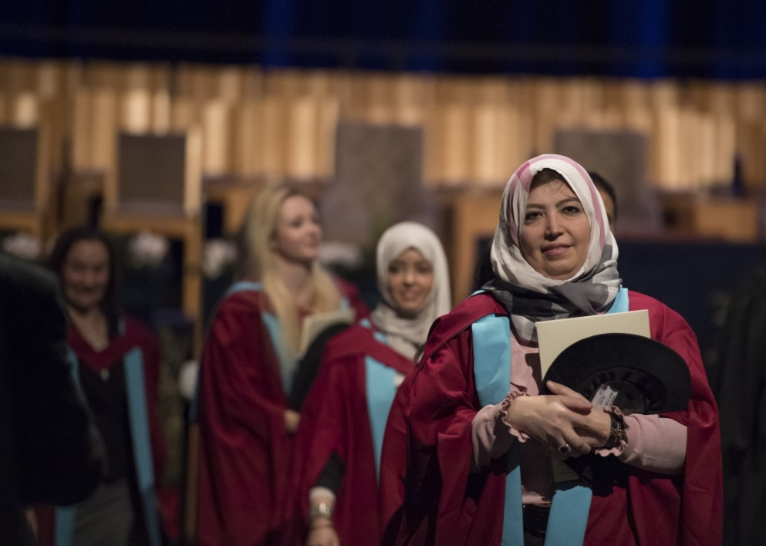
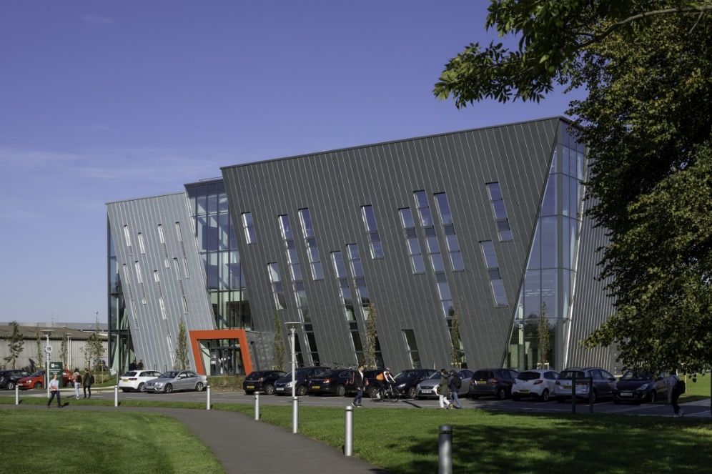
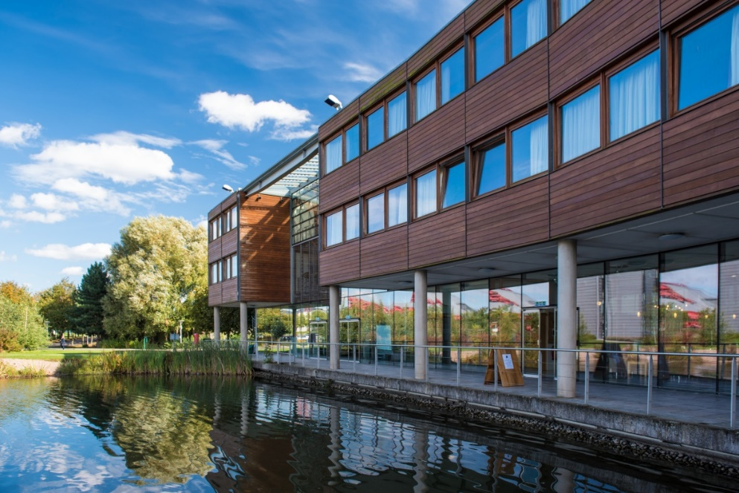
A little about Nottingham
7 campuses, 5 Faculties across 3 countries and 2 continents
1,800 acres, 450 buildings, 750,000 M2
47,953 students worldwide
9,000 staff world-wide
£1.1bn of annual economic impact in the UK
18,000 jobs supported by University activity
£850m annual income
60% of research income linked to industry
Notes:
Nottingham population is 331,000 which makes Nottingham University around 12.5% of population equivalent.
Student stats: https://www.nottingham.ac.uk/ppsc/student-statistics/student-statistics-2019-20.aspx

Slide 4
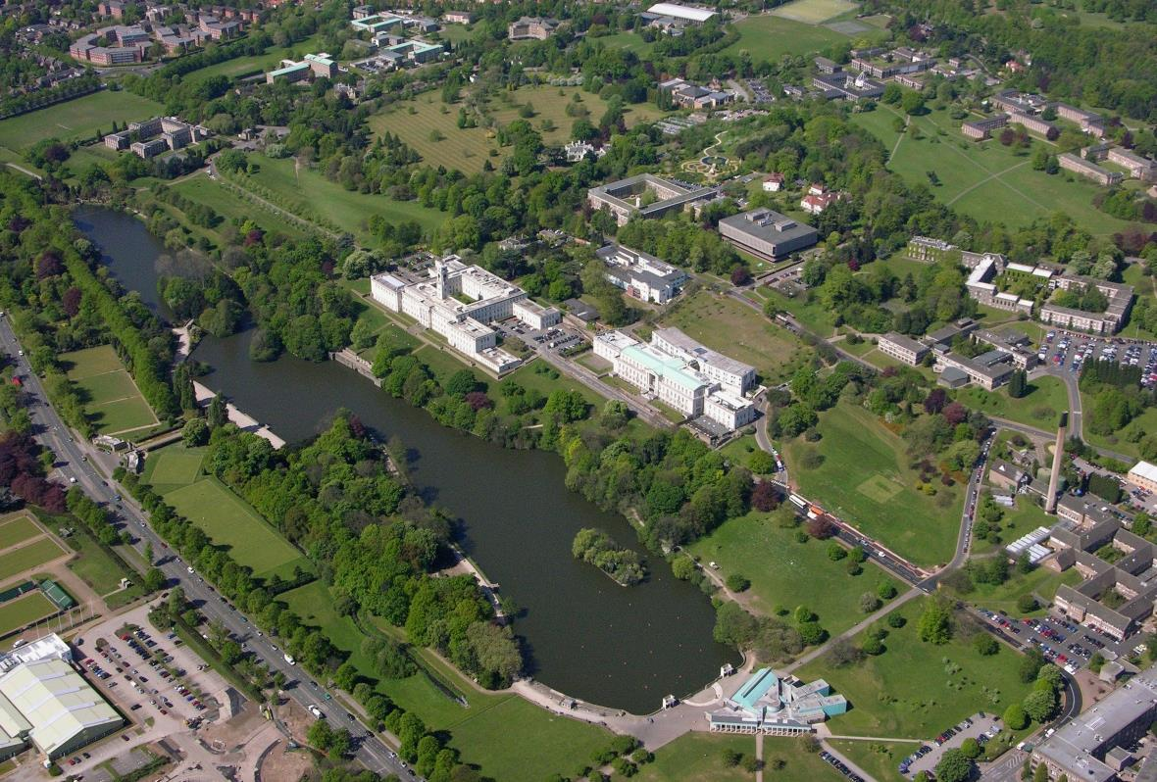
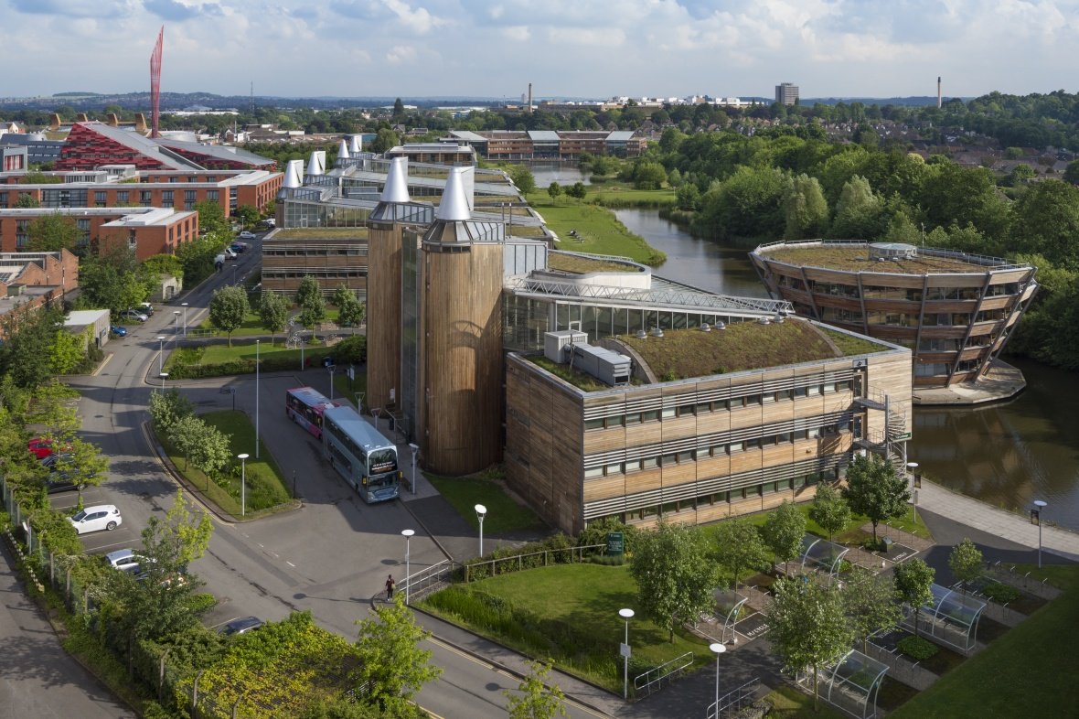
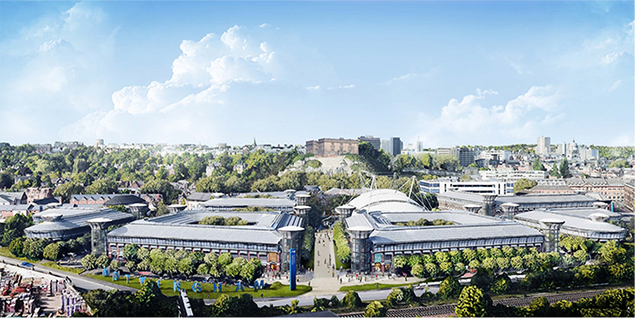
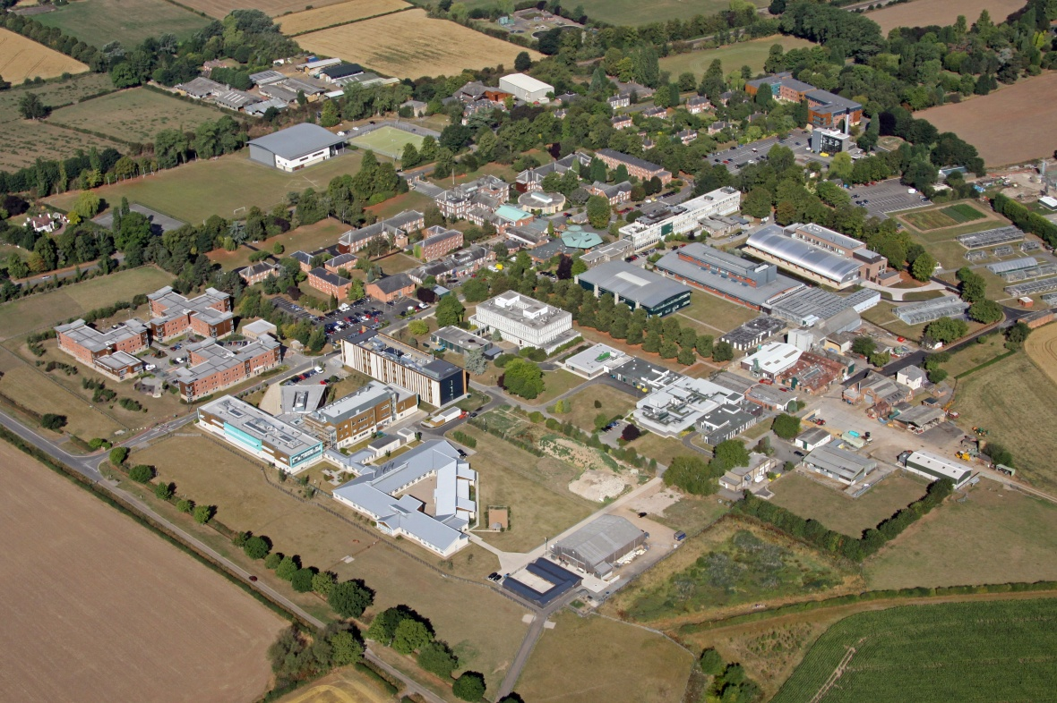
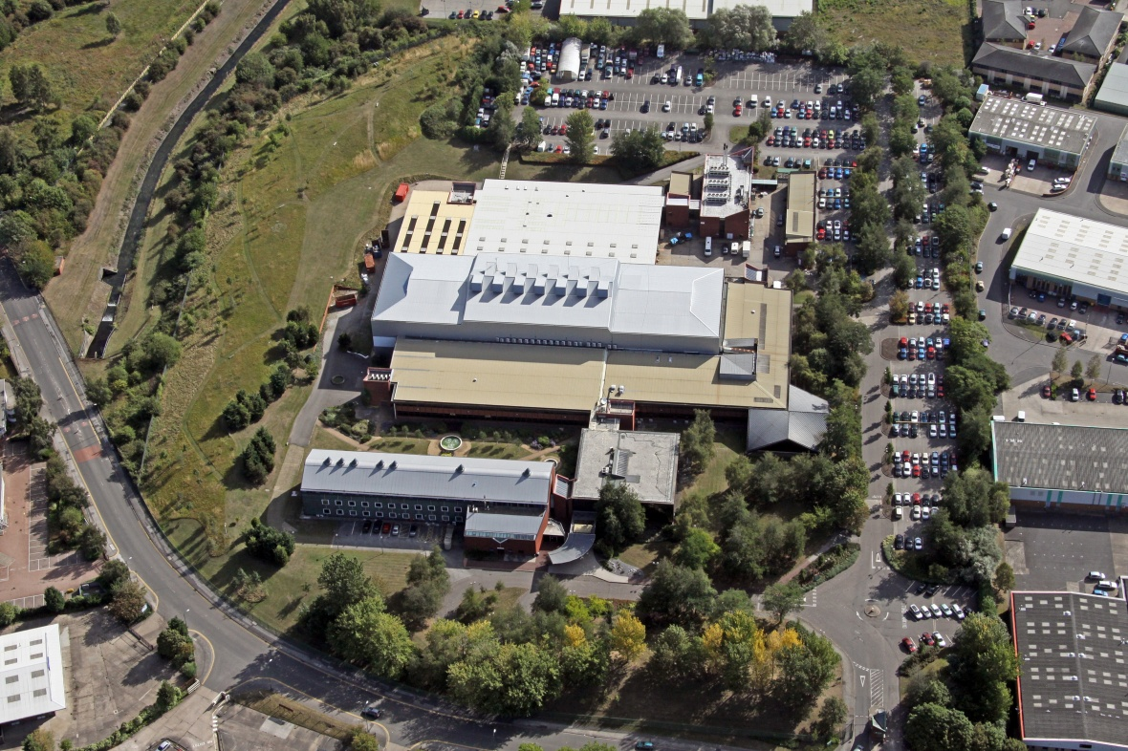
UK campuses
Castle Meadow Campus
University Park Campus
Jubilee Campus
Sutton Bonington Campus
King’s Meadow Campus
Notes:
Plus sites at QMC med school, City Hospital and Royal Derby

Slide 5
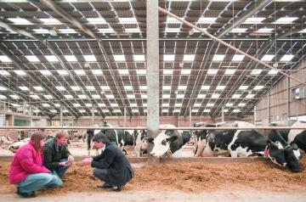
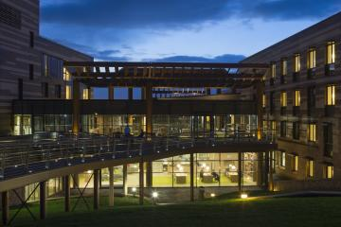
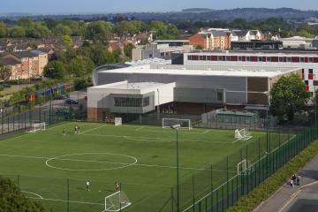
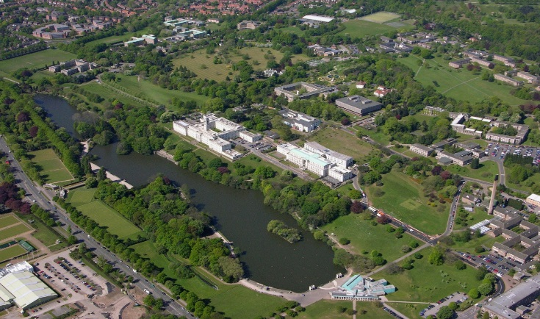
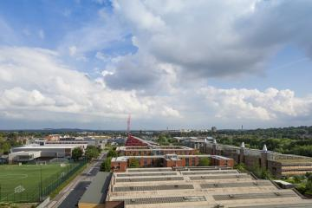
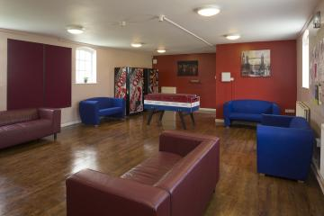
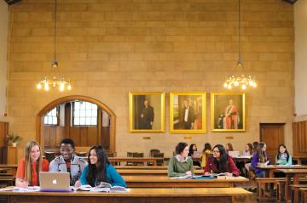
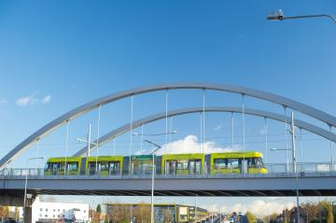
UoN UK - It’s like a small town …
Notes:
The oldest building built on the University land is Hugh Stewart House, built in 1792
We own 543 hectares of real estate in the UK (which is three times bigger than Monaco and 8.5 times the size of Disneyland Florida)
including a cave (Nottingham Rock), Beeston Clock Tower, forests at Diamond Woods (Sutton Bonington), Beeston Fields (Beeston) and Bunny Park
4000+ Halls of Residence bed spaces
200+ other residences
Shops
Libraries
GP, Pharmacy, Counselling
Art Gallery
Recital Hall
Hotel
Restaurants
Bars
Sports Centre
2 conference centres
Lakes
Rivers
Farm
Security services
Waste Collection
Highway network w/ streetlighting
3000+ car parking spaces
Bus, tram and Cycle Hire Scheme
Energy generation, heat and power networks

Slide 6
Our commitment to sustainability
“We will place a special emphasis on environmental sustainability, supporting the City of Nottingham's desire to be a net zero carbon city by 2028 and working with partners in China and Malaysia to improve sustainability within their regions.”
Notes:
The University Strategy was published in December 2019. It made explicit reference to the UN Sustainable Development Goals (SDGs) and sustainability.
“We will place a special emphasis on environmental sustainability, supporting the City of Nottingham’s desire to be a net zero carbon city by 2028 and working with partners in China and Malaysia. We will make an outstanding contribution to supporting the UN SDGs through our research and education, our engagement with partners and our behaviour on campus and in our communities.”
The SDGs are 17 interlinked global goals designed to be a blueprint to achieve a better and more sustainable future for all.
The strategy means we’re committed to delivering against these goals in terms of:
Research and knowledge exchange
Teaching and learning,
How we operate – how are campus are designed, built and run

Slide 7
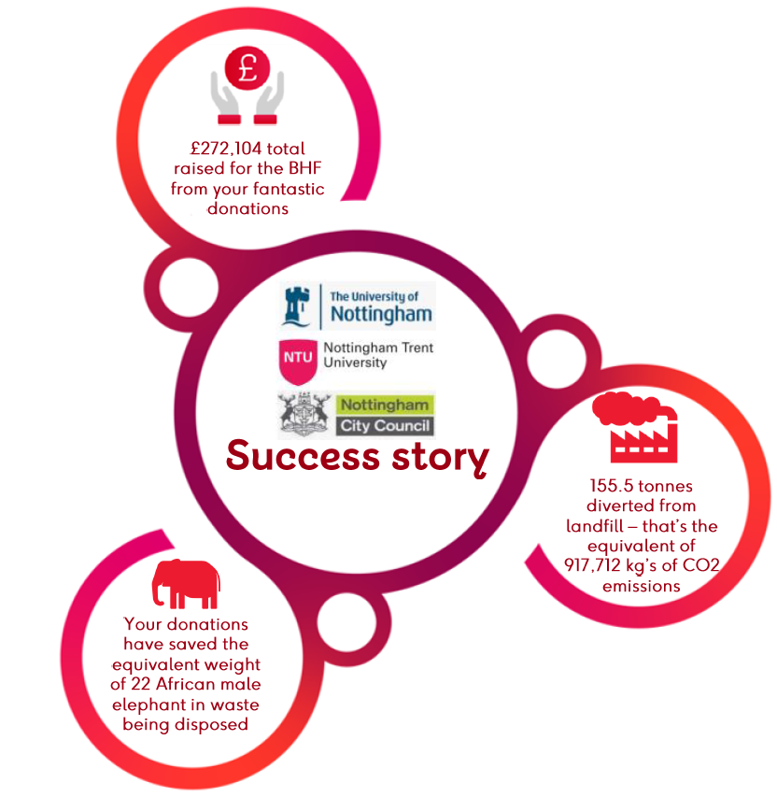
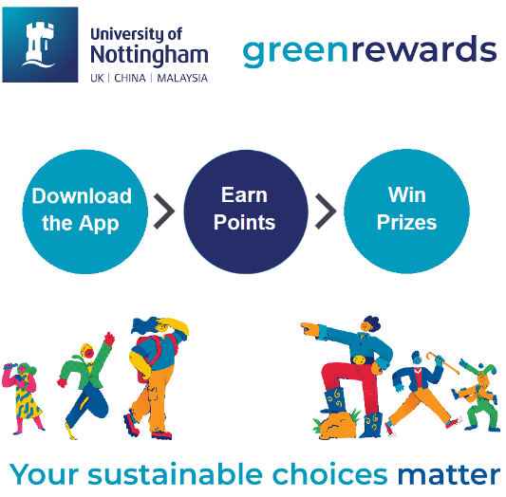
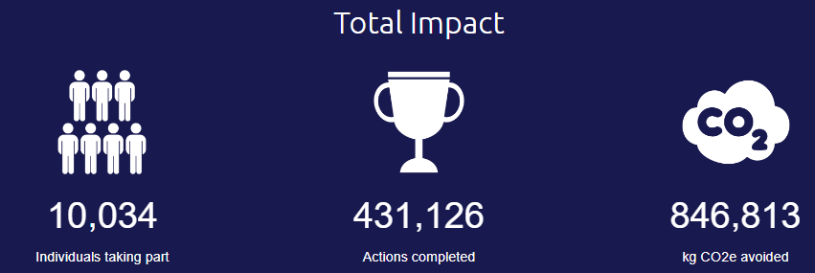
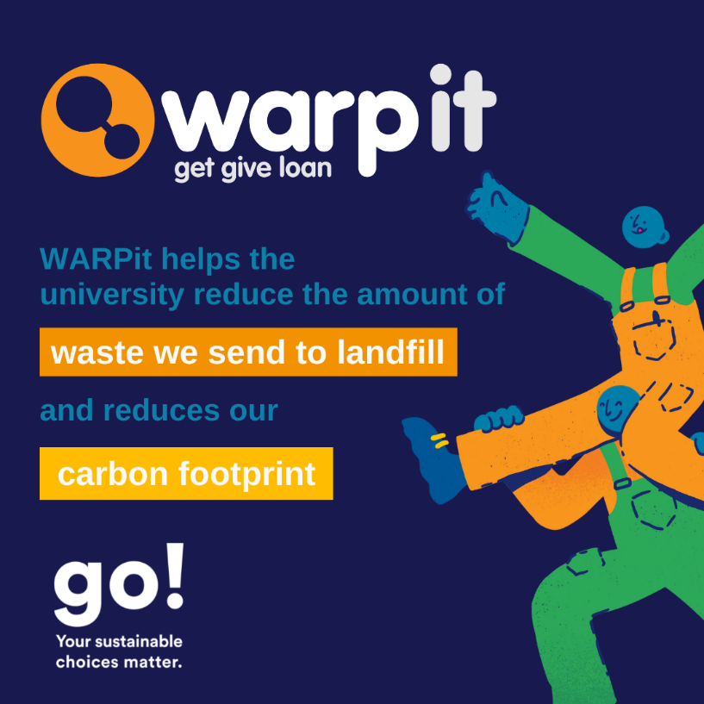
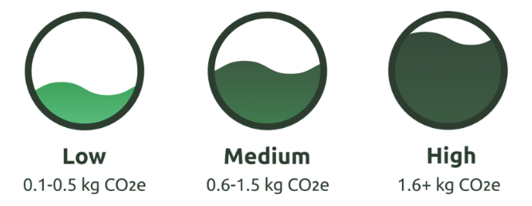
The journey……
Operational improvements across the estate
Notes:
We’ve made significant progress in driving the environmental agenda in the past decade and have been developing our response to the climate crisis.
These are some of the things we have achieved.
Environmental Sustainability Strategic Delivery Plan – sets out our priorities to deliver against the uni strategy.
Action plan
Environmental Sustainability Engagement Plan
Biodiversity Action Plan
“Locking in the benefits of lockdown” action plan
CMP – road

Slide 8
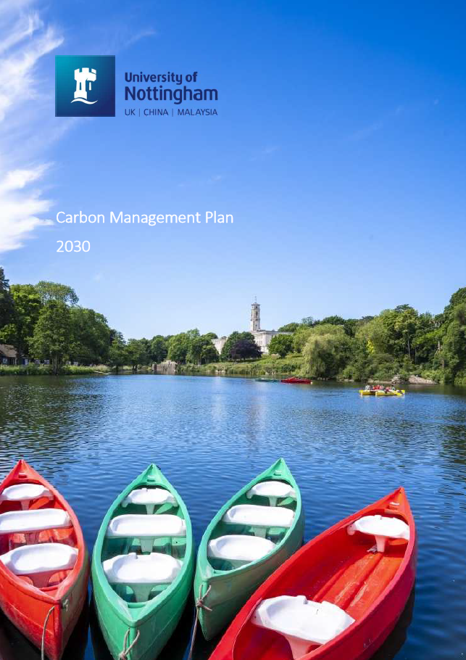
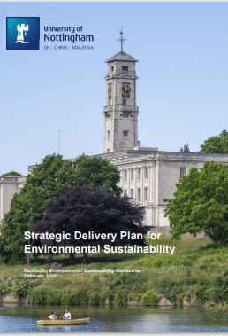
The journey…..
Divestment from fossil fuels 2019
Climate emergency recognised in 2020
Strong research on sustainability themes
Switched to more sustainable investment funds 2021
Strategic Delivery Plan 2021
New committee and governance structure
Set new carbon reduction targets to 2030 Carbon Management Plan
Consistent high score in UI Green Metric
Notes:
We’ve made significant progress in driving the environmental agenda in the past decade and have been developing our response to the climate crisis.
These are some of the things we have achieved.
Environmental Sustainability Strategic Delivery Plan – sets out our priorities to deliver against the uni strategy.
Action plan
Environmental Sustainability Engagement Plan
Biodiversity Action Plan
“Locking in the benefits of lockdown” action plan
CMP – road

Slide 9
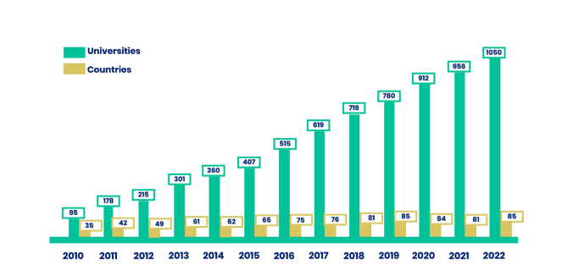
UI GreenMetric
Established in 2010
Grown in scale and reach
Numeric evidence led self assessment
Light touch
UI GreenMetric World University Ranking is a ranking on green campus and environmental sustainability within institutions

Slide 10
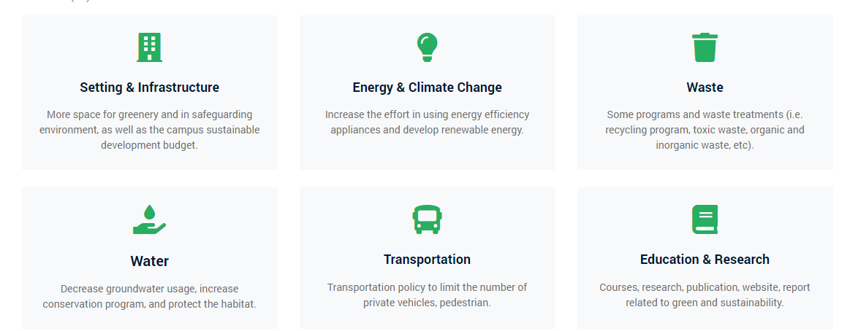
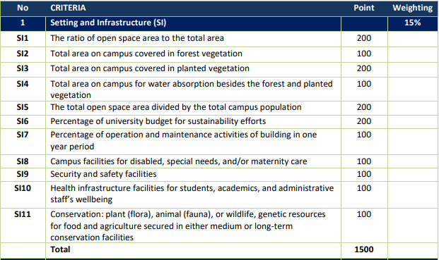
How it works

Slide 11
Benefits
Global recognition
Methodology
Ease
Network
Additional support
Alignment to the SDG’s

Slide 12
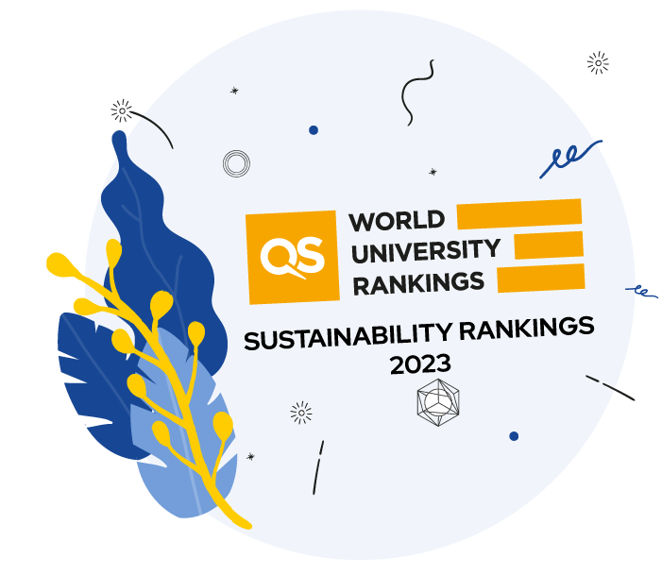
Challenges
League fatigue
Self assessment???
Global in nature
Academic scrutiny
Policy focus rather than impact led?
Which metrics

Slide 13
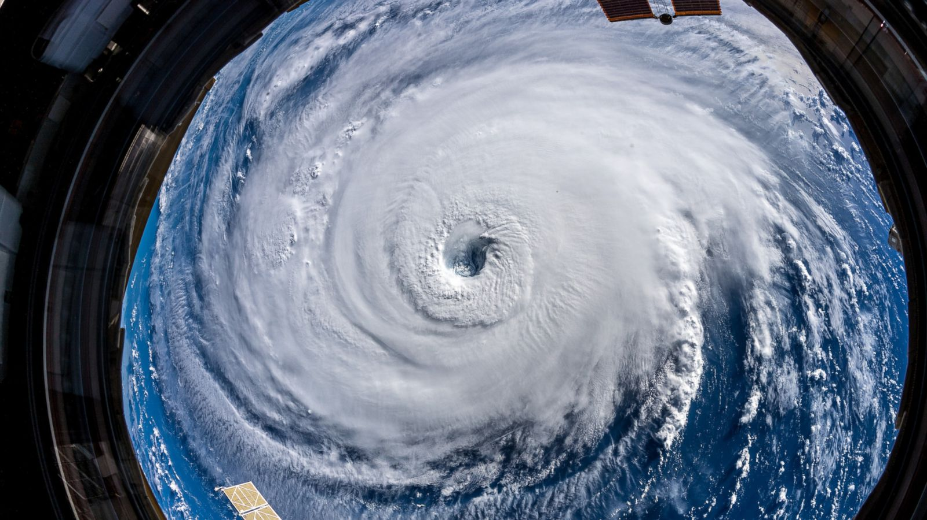
Sustainability
Global Pandemic
Increased profile of agenda
Energy crisis
Climatic anomalies
Costs and Inflation
Student Experience
Mental health crisis
Climate anxiety increasing
Carbon reduction target’s (1 and 2)
Agile working and Space utilisation
Estate Size and Shape
Backlog investment needs
Embodied carbon

Slide 14
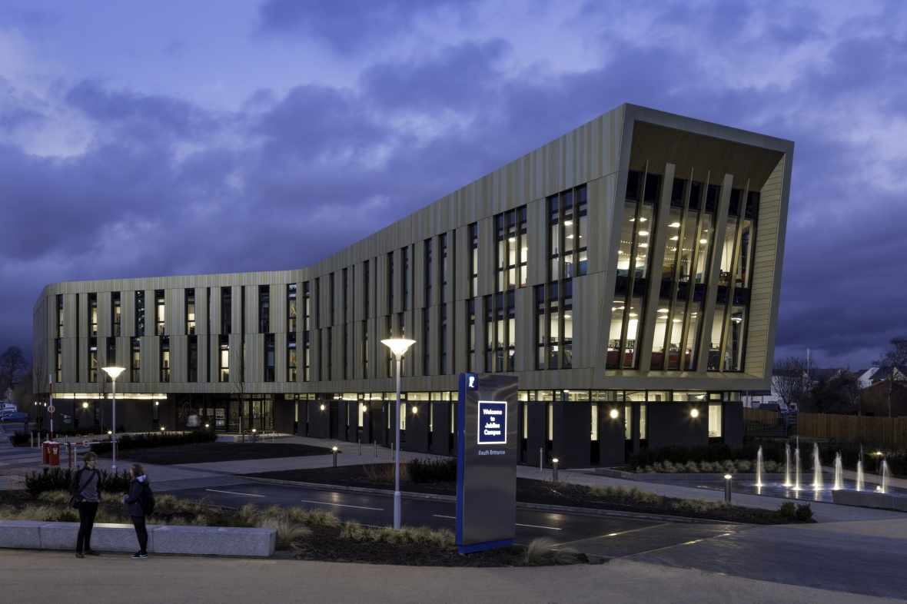
Next steps for Nottingham
THE Impact and UI Green Metric Submission
Upskill and engage our community – collective responsibility
Developing detailed road maps for decarbonisation
Accelerate on site generation of energy
University travel
Downsize / right size
Secure funding partnerships
Curriculum refresh
Notes:
Meet carbon reduction targets
Customer satisfaction
Reduce energy cost
Improve Efficiency
Improve resilience of energy systems

Slide 15
Any questions?
sustainability@nottingham.ac.uk
UoN Sustainability
@UoNSustain

